Slide 1
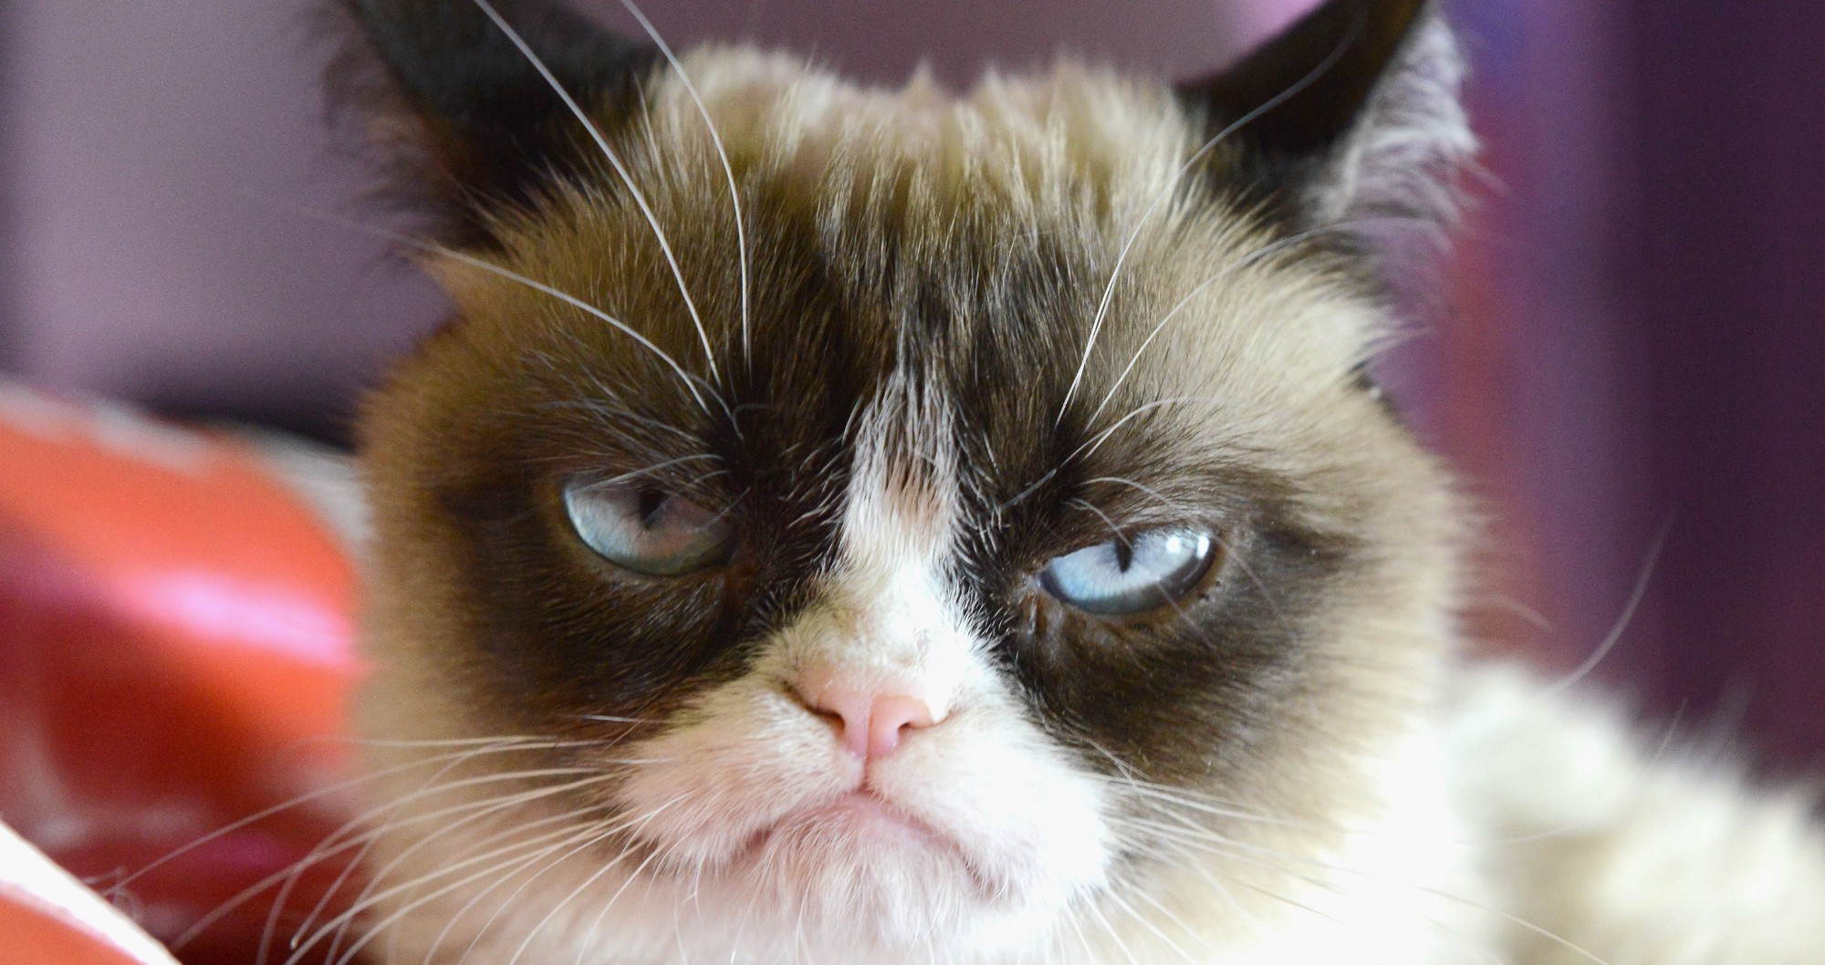
Quelle est la couleur préférée de ce chat?
This Photo by Unknown author is licensed under CC BY.

Slide 2
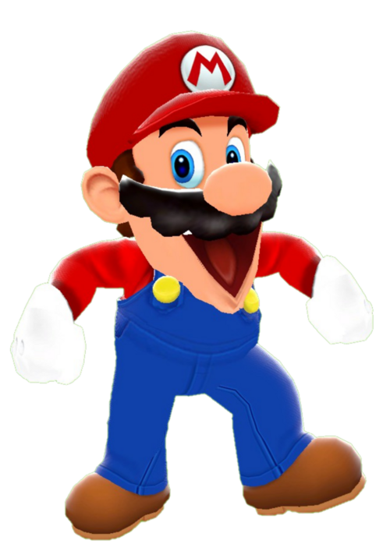
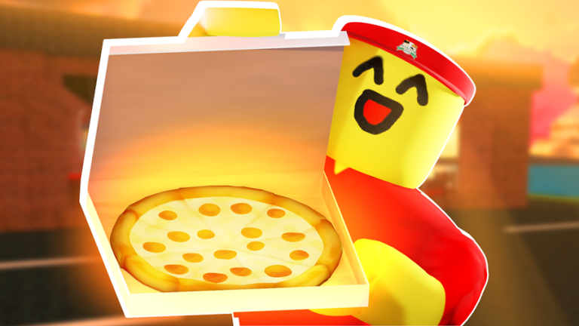
Est-ce que ta couleur préférée c'est le rouge?
This Photo by Unknown author is licensed under CC BY-SA.
This Photo by Unknown author is licensed under CC BY-SA-NC.
This Photo by Unknown author is licensed under CC BY-SA.

Slide 3
Je n'aime pas le rouge.
This Photo by Unknown author is licensed under CC BY-NC-ND.

Slide 4
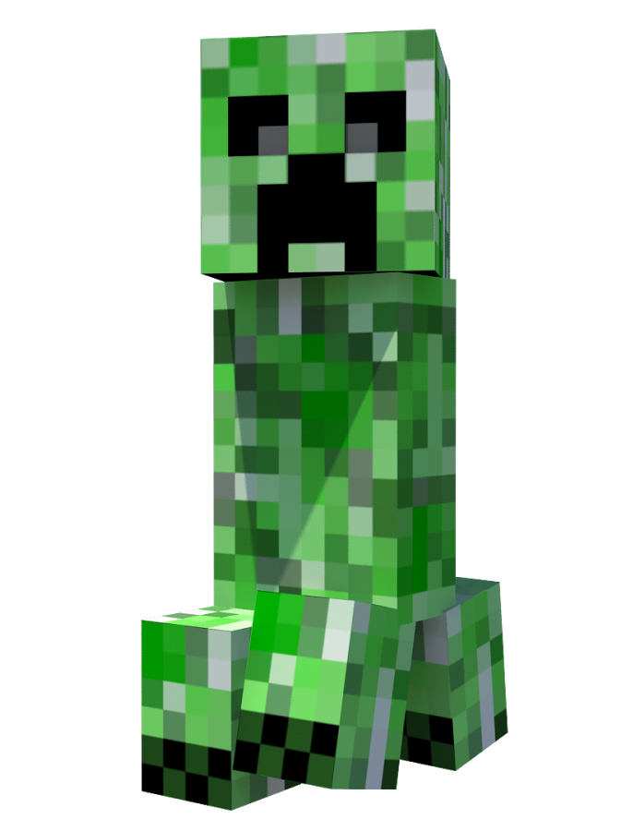
Est-ce que ta couleur préférée c'est le vert?
This Photo by Unknown author is licensed under CC BY-SA-NC.
This Photo by Unknown author is licensed under CC BY-SA-NC.
This Photo by Unknown author is licensed under CC BY-NC.
This Photo by Unknown author is licensed under CC BY-NC-ND.
This Photo by Unknown author is licensed under CC BY-SA-NC.

Slide 5
Je n'aime pas le vert.
This Photo by Unknown author is licensed under CC BY-NC-ND.

Slide 6
Est-ce que ta couleur préférée c'est le jaune?
This Photo by Unknown author is licensed under CC BY.
This Photo by Unknown author is licensed under CC BY-SA-NC.

Slide 7
Je n'aime pas le jaune
This Photo by Unknown author is licensed under CC BY-NC-ND.

Slide 8
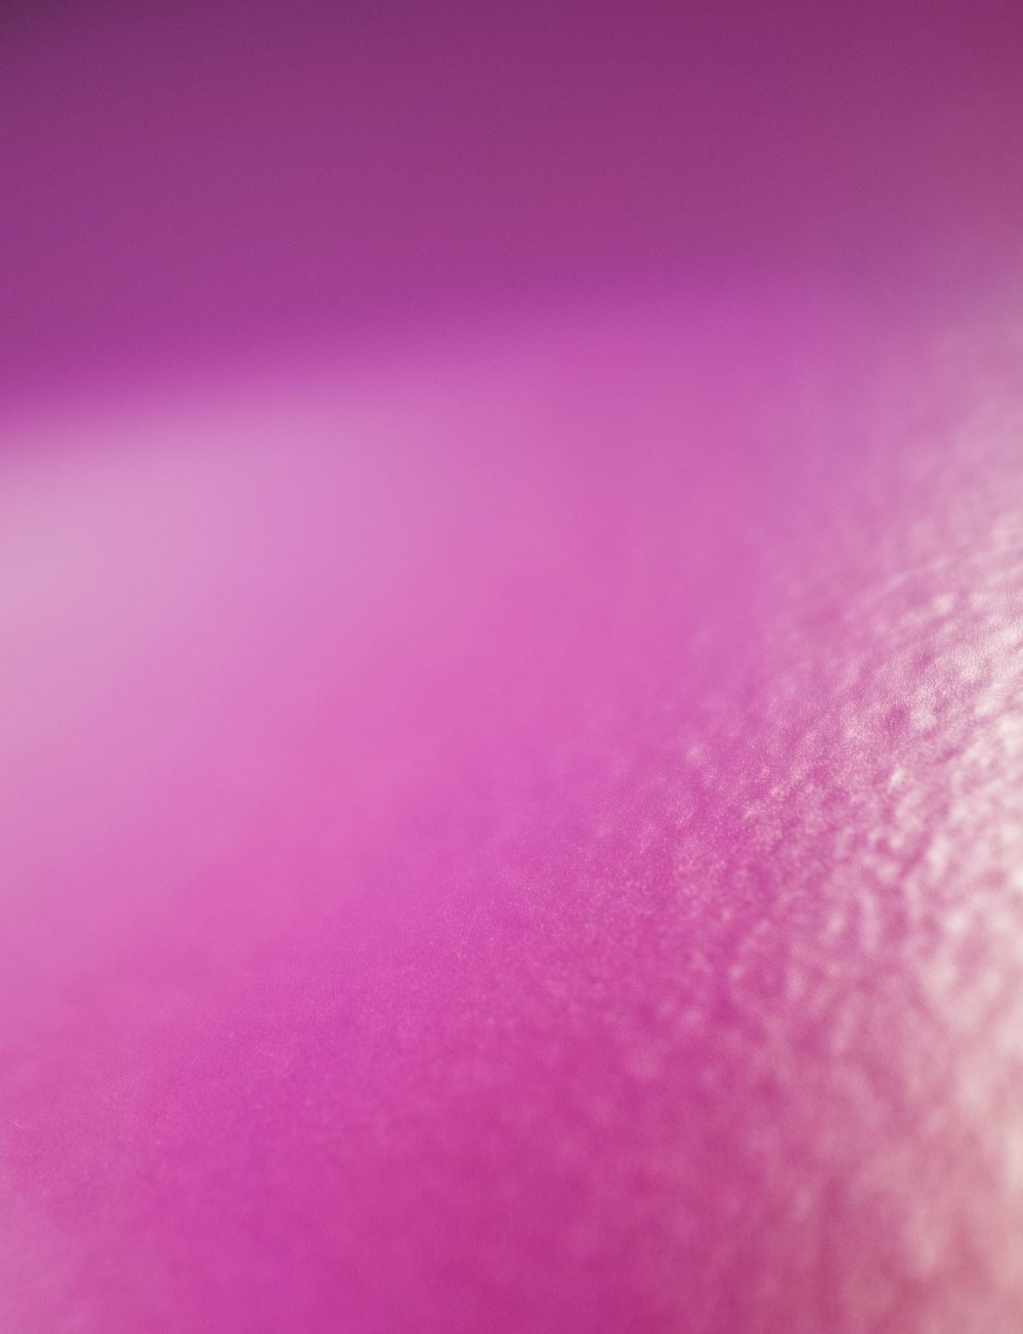
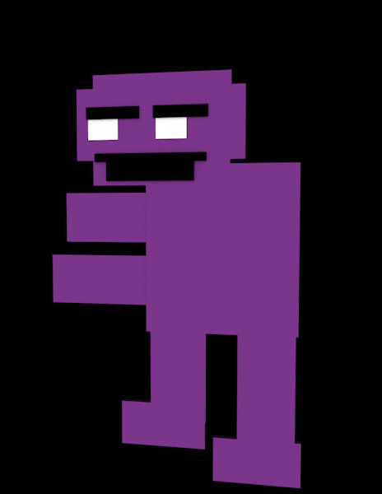
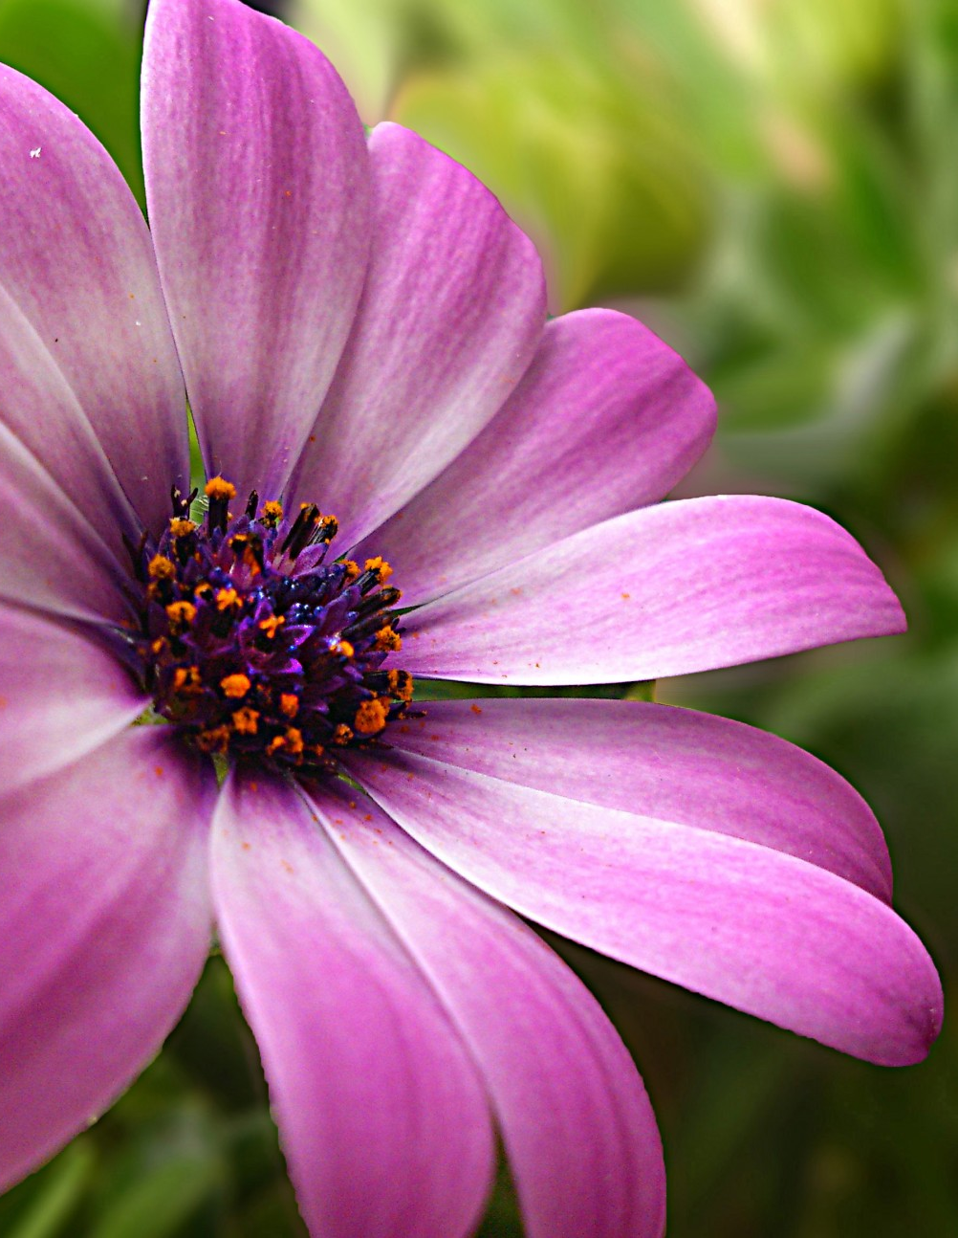
Est-ce que ta couleur préférée est le violet?
This Photo by Unknown author is licensed under CC BY-NC-ND.

Slide 9
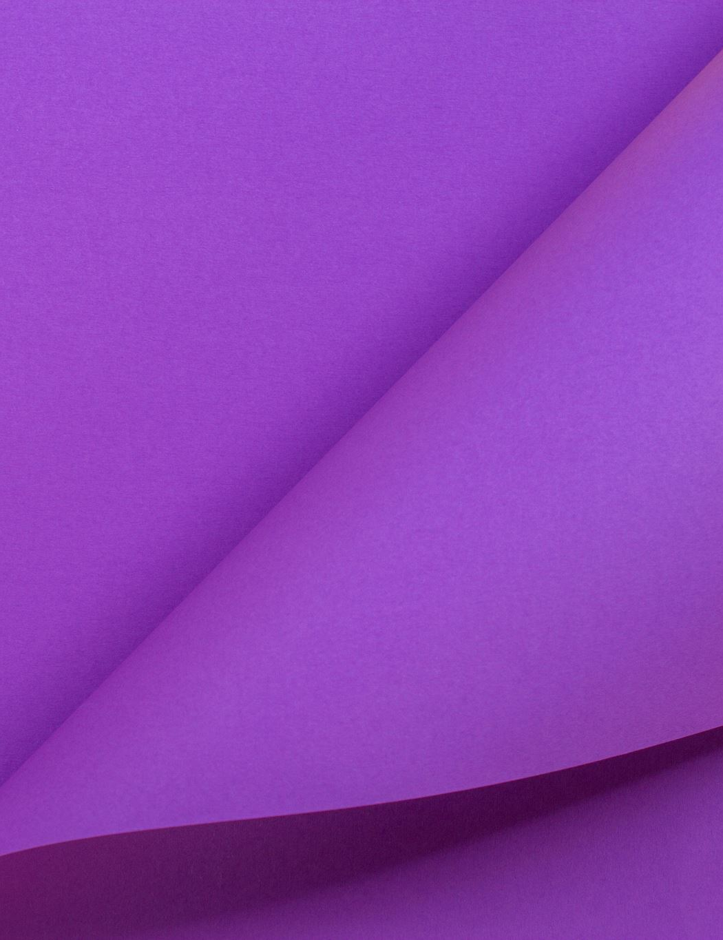
Oui ma couleur préférée est le violet.
This Photo by Unknown author is licensed under CC BY.

