Slide 1
PRESENTS

Slide 2
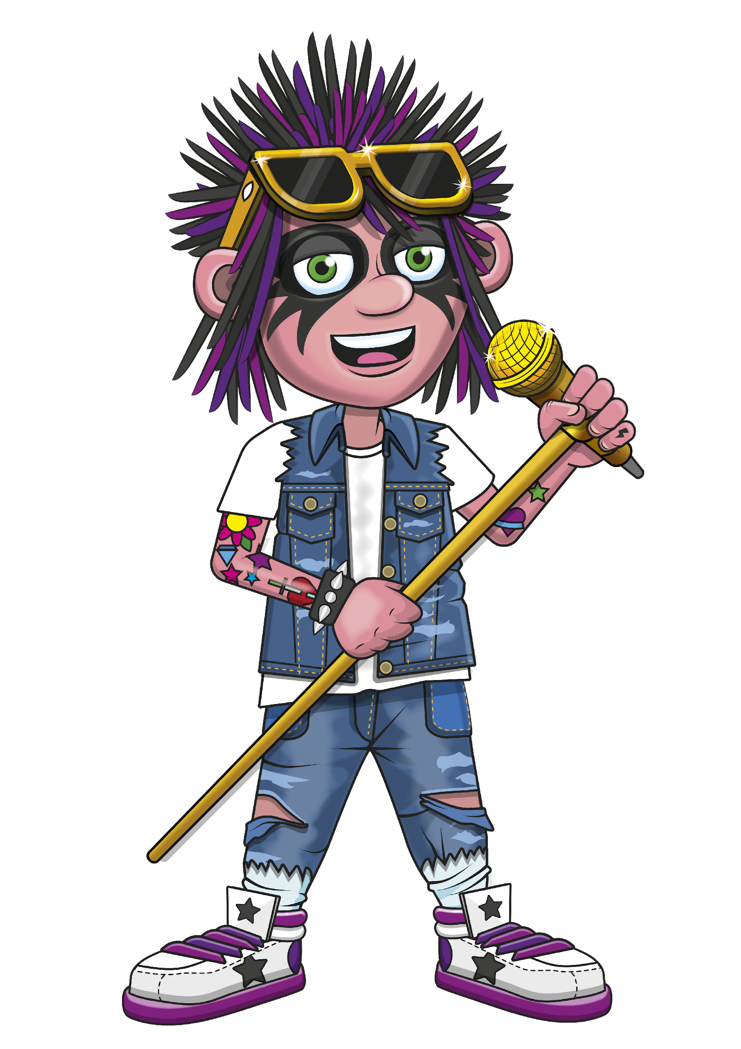
A GUIDE TO THE MTC
GUIDE

Slide 3
WHAT ARE WE GOING TO COVER?
What is the MTC?
MTC key facts.
Preparing pupils for the MTC.
Q & A time.

Slide 4
INTRODUCTION
The Multiplication Tables Check (MTC) needn’t be daunting!
For many pupils, it’s a fantastic opportunity for pupils to show off their fluency with their tables, which they’ve been practicing for years.

Slide 5
WHAT IS THE MTC?
The MTC stands for Multiplication Tables Check.
Set by the government, the MTC is an on-screen assessment designed to determine whether pupils are able to fluently recall their multiplication tables up to 12, through a set of timed questions.

Slide 6
MTC KEY FACTS.
There is a 2-week check window starting 3rd June 2024 during which schools will complete the MTC with pupils in Year 4.
Pupils will have 3 practice questions before the check begins.

Slide 7
MTC KEY FACTS
The MTC will ask the pupil 25 random multiplication questions- they will not be asked division questions.
Pupils will have 6 seconds to read the question, understand it, and enter a response. They will then receive a 3 second pause before the next question is shown.
Notes:
·
·

Slide 8
MTC KEY FACTS.
Schools can decide whether the pupils take the test on a tablet or a computer, but there is no option to complete the test on paper.
Teachers will have the flexibility to administer the check to individual pupils, small groups or a whole class at the same time.
There is no pass mark for the MTC.
▪At St Luke’s we will administer the test in small groups and on laptops.

Slide 9
MTC RESULTS
After the MTC window closes, schools will be able to compare their school average, with their Local Authority and National average.
More guidance can be found here
▪Your child’s (childrens’) results will be shared with you on a results slip, alongside their end of year report.

Slide 10
PREPARING PUPILS : SCHOOL
We might be spending a bit more time practising our times tables in class.
Children might be set more times tables specific homework.
We might be organising more class tournaments and asking pupils to play on Times Tables Rock Stars 15 minutes a week.
Notes:
Please edit this page as you wish!

Slide 11
PREPARING PUPILS : OUT OF SCHOOL
Regular verbal times tables practice.
Download the TTRS free app on to a home device.
Play Times Tables Rock Stars 3 minutes a day.
Please speak to your child's class teacher if you have any further questions.
Notes:
Please edit this page as you wish!

