Slide 1
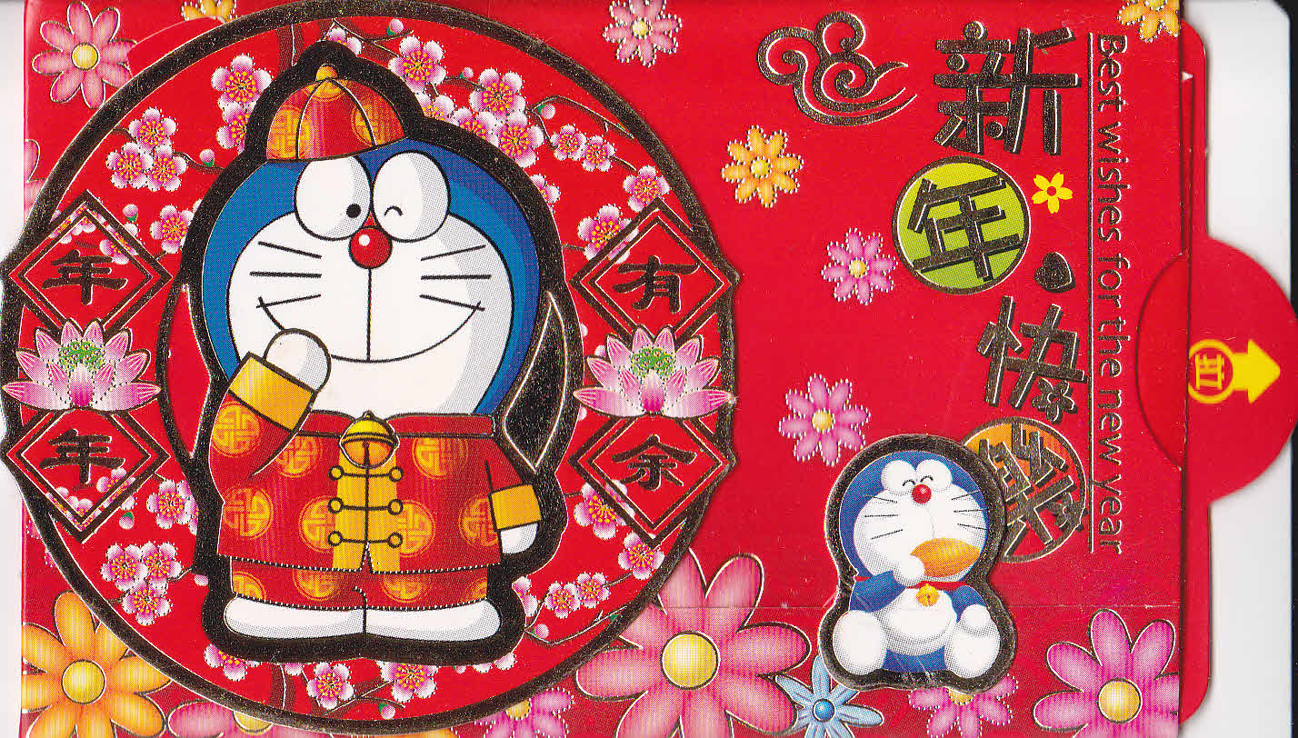


Happy Lunar New Year!
To learn how to say it in Vietnamese, you can repeat after Beatrice from Y6.
This Photo by Unknown author is licensed under CC BY-ND.

Slide 2

Wishing you
happiness and prosperity!
To learn how to say it in Cantonese, you can repeat after Imogen from Y6.
This Photo by Unknown author is licensed under CC BY.

Slide 3

Thank you very much
to Beatrice and Imogen
for sharing their knowledge and time
with us!
If you would like to share your knowledge of another language with us please let Madame Col (Yolenn) know.
This Photo by Unknown Author is licensed under CC BY-SA-NC

