Slide 1
Year 6 SATs 2023 Presentation for parents and carers

Slide 2
What are the SATs?
SATs are the Standardised Assessment Tests that are given to children at the end of Key Stage 2.
The SATs take place over four days, starting on Tuesday 9th May ending on Friday 12th May.
The SATs papers consist of:
Spelling, punctuation and grammar (GPS)– Tuesday 9th May
Paper 2: Spelling- Tuesday 9th May
English Reading Paper – Wednesday 10th May
Maths (paper 1: Arithmetic) – Thursday 11th May
Maths (paper 2: Reasoning) – Thursday 11th May
Maths (paper 3: Reasoning) – Friday 12th May
Writing is assessed using evidence collected throughout Year 6. There is no Year 6 SATs writing test.
The key stage 2 tests will be taken on set dates unless your child is absent, in which case they may be able to take them up to 5 school days afterwards.

Slide 3
When and how the SATs are completed
The tests take place during normal school hours, under test conditions.
After the tests are completed, the papers are sent away to be marked externally.
The results are then sent to the school in July.
Each test lasts no longer than 60 minutes:
Spelling, punctuation and grammar (paper 1: Grammar/ Punctuation) – 45 minutes
Spelling, punctuation and grammar (paper 2: Spelling) – 15 minutes
Reading – 60 minutes
Maths (paper 1: Arithmetic) – 30 minutes
Maths (paper 2: Reasoning) – 40 minutes
Maths (paper 3: Reasoning) – 40 minutes

Slide 4
Specific arrangements for SATs
Children with additional needs (who have similar support as part of day-to-day learning in school) may be allotted specific arrangements, including:
Additional (extra) time;
Tests being opened early to be modified;
An adult to scribe (write) for them;
Using word processors independently;
An adult to read for them;
The use of prompts or rest breaks;
Arrangements for children who are ill or injured at the time of the tests.
Pupils with an EHCP are automatically allowed up to 25% additional time (except for the spelling paper, which is not strictly timed). Pupils who use the modified large print or braille versions of the tests are automatically allowed up to 100% additional time.

Slide 5
The results
Tests are marked externally. Once marked, the tests will be given the following scores:
A raw score (total number of marks achieved for each paper);
A scaled score (see below);
A judgement on if the National Standard has been met.
After marking each test, the external marker will convert the raw score to a scaled score. Even though the tests are made to the same standard each year, the questions must be different. This means the difficulty of the tests may vary. Scaled scores ensures an accurate comparison of performance over time.
Scaled scores range from 80 to 120.
A scaled score of 100 or more shows the pupil is meeting the National Standard.

Slide 6
Spelling, Punctuation and Grammar: Tuesday 9th May
Spelling, Punctuation and Grammar consists of two papers.
Paper 1 focuses on all three elements (spelling, punctuation and grammar). The paper lasts for 45 minutes.
Paper 2 consists of a spelling test only. It should take approximately 15 minutes, although this is not a set amount of time (pupils should be given as much time as they need to complete the test).
This test includes 2 types of questions:
Selected Response: Identify the adjectives in the sentence below
Constructed Response: The can be correct/ complete/ rewrite the sentence or Explain their answer/choice.

Slide 7
Spelling, Punctuation and Grammar: Paper 1
The children will have been working hard with their class teacher on developing and securing their knowledge of the technical vocabulary needed in this test.
This test focuses on:
Grammatical terms/ word classes;
Functions of sentences;
Combining words, phrases and clauses;
Verb forms, tenses and consistency;
Punctuation;
Vocabulary;
Standard English and formality.
This test requires a range of answer types but does not require longer formal answers.

Slide 8
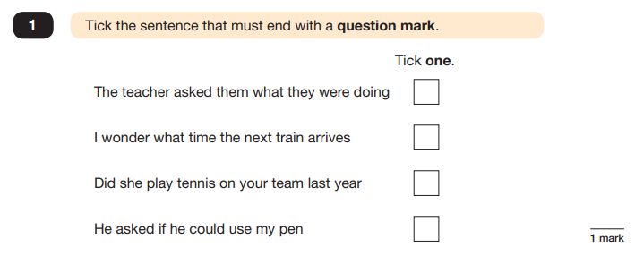
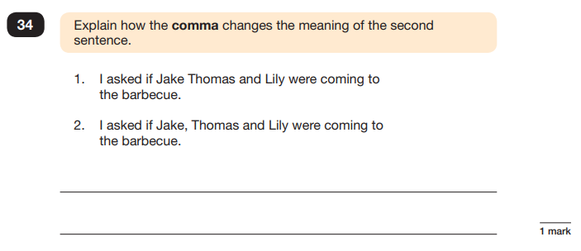
Spelling, Punctuation and Grammar: Paper 1
Example questions:
e.g. that, which
✓
e.g. The first sentence is about two people and the second sentence is about three people.

Slide 9
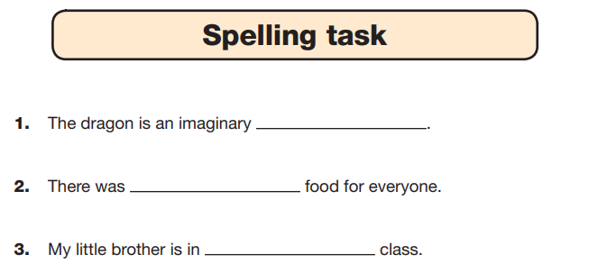
Spelling, Punctuation and Grammar: Paper 2
Paper 2 is a shorter paper that focuses solely on spellings.
Example questions:

Slide 10
Reading: Wednesday 10th May
There is one reading test that lasts for 60 minutes.
The test is designed to measure if the children’s comprehension of age-appropriate reading material meets the national standard. There are three different set texts for children to read. These could be any combination of non-fiction, fiction and/ or poetry.
The test covers the following areas (known as Content Domains):
Give/ explain the meaning of words in context;
Retrieve and record information/ identify key details from fiction and non-fiction;
Summarise main ideas from more than one paragraph;
Make inferences from the text/ explain and justify inferences with evidence from the text;
Predict what might happen from details stated and implied;
Identify/ explain how information/ narrative content is related and contributes to meaning as a whole;
Identify/ explain how meaning is enhanced through choice of words and phrases;
Make comparisons within the text.

Slide 11
Reading question types
Types of questions children might encounter:
Ranking/ordering- e.g. ‘Number the events below to show the order in which they happen in the story’ Labelling, e.g. ‘Label the text to show the title of the story’
Find and copy- One word or sentence e.g. ‘Find and copy one word that suggests what the weather is like in the story’
Multiple Choice- e.g. Tick the sentence that is closest to the meaning of the word…
Short constructed response- Short answer questions e.g. ‘What does the bear eat?’
Open-ended response- Long answer questions e.g. ‘Look at the sentence that begins Once upon a time. How does the writer increase the tension throughout this paragraph? Explain fully, referring to the text in your answer.’

Slide 12
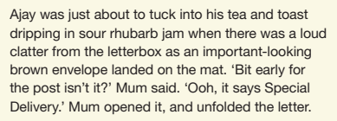
Reading
The reading SATs paper requires a range of answer styles.
Example questions:

Slide 13
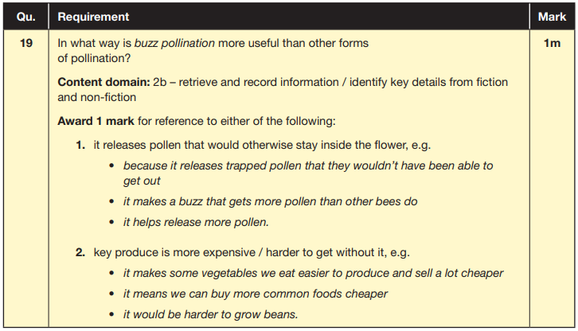
Reading
Example questions:
Based on text 2: Fact Sheet: About Bumblebees

Slide 14
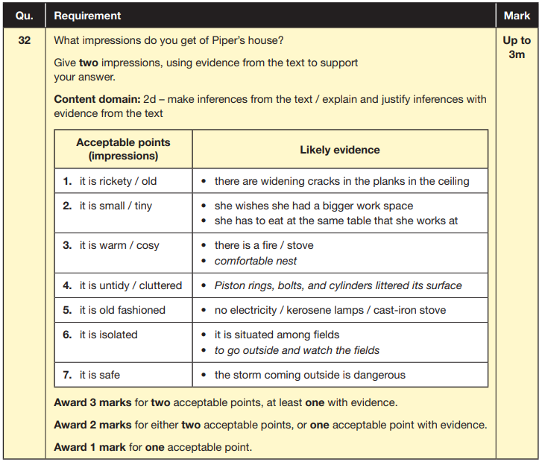
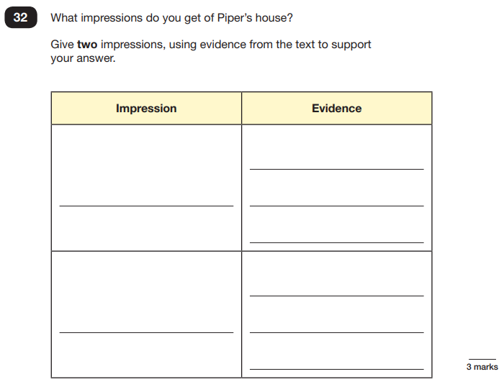
Reading
Example questions:
Based on text 3: Music Box

Slide 15
Maths: Thursday 11th May and Friday 12th May
The maths assessments consist of three tests.
Paper 1: Arithmetic (30 minutes) – Thursday 11th May
Paper 2: Reasoning (40 minutes) – Thursday 11th May
Paper 3: Reasoning (40 minutes) – Friday 12th May

Slide 16
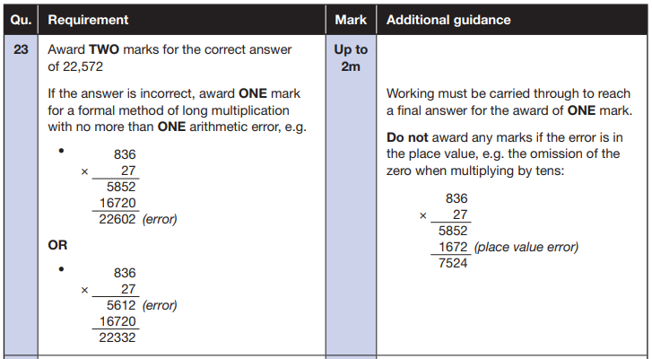
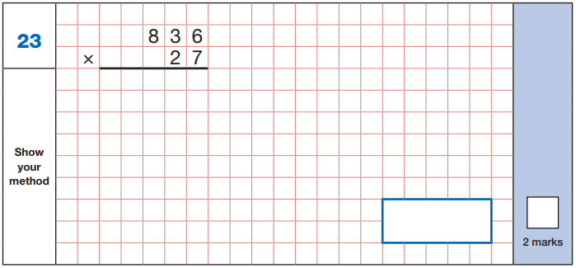
Maths Paper 1 (Arithmetic)
The maths arithmetic paper has a total of 40 marks.
The test covers the four operations (addition, subtraction, multiplication, division, including order of operations requiring BIDMAS), percentages of amounts and calculating with decimals and fractions.
Questions will consist of fixed response questions, where children have to give the correct answer to calculations, including long multiplication and division.
Example question:

Slide 17
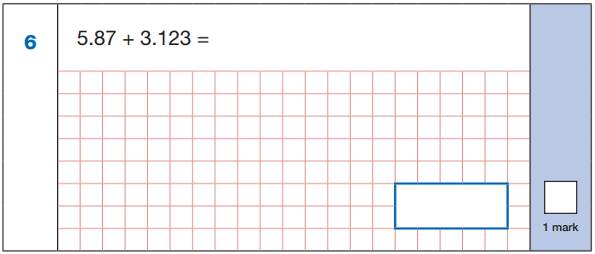
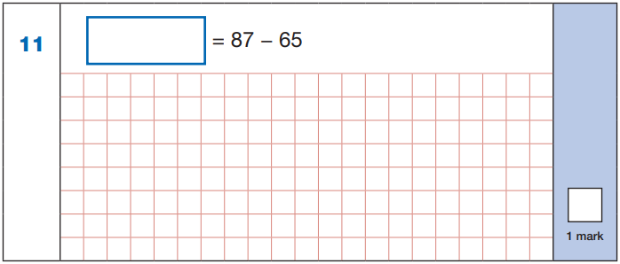
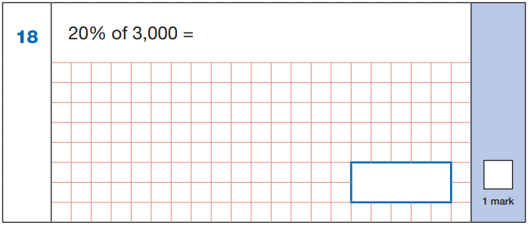
Maths Paper 1 (Arithmetic)
Example questions:
22
5.87
+ 3.123
8.993
87
- 65
22
8.993
60 ÷ (30 - 24)
60 ÷ 6 = 10
10% of 3,000 = 300
20% of 3,000 = 600
10
600

Slide 18
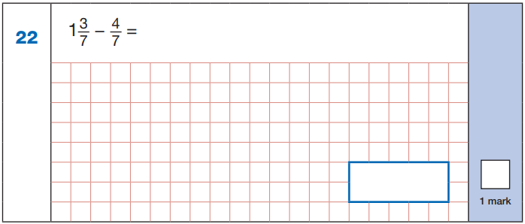
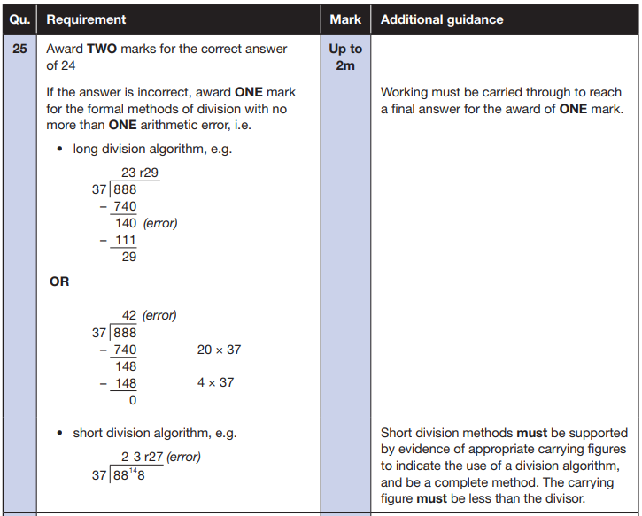
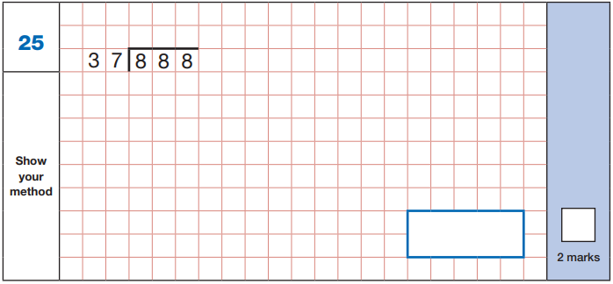
Maths Paper 1 (Arithmetic)
Example questions:
$\frac{\text{10}}{\text{7}}$ - $\frac{\text{4}}{\text{7}}$ = $\frac{\text{6}}{\text{7}}$
$\frac{\text{6}}{\text{7}}$

Slide 19
Maths Papers 2 and 3 (Reasoning)
Paper 2 will take place on Thursday 11th May and paper 3 will take place on Friday 12th May. These tests have a total of 35 marks each.
These papers require children to demonstrate their mathematical knowledge and skills, as well as their ability to solve problems and their mathematical reasoning. They cover a wide range of mathematical topics from key stage 2 including,
Number and place value (including Roman numerals);
The four operations;
Geometry (properties of shape, position and direction);
Statistics;
Measurement (length, perimeter, mass, volume, time, money);
Algebra;
Ratio and proportion;
Fractions, decimals and percentages.

Slide 20
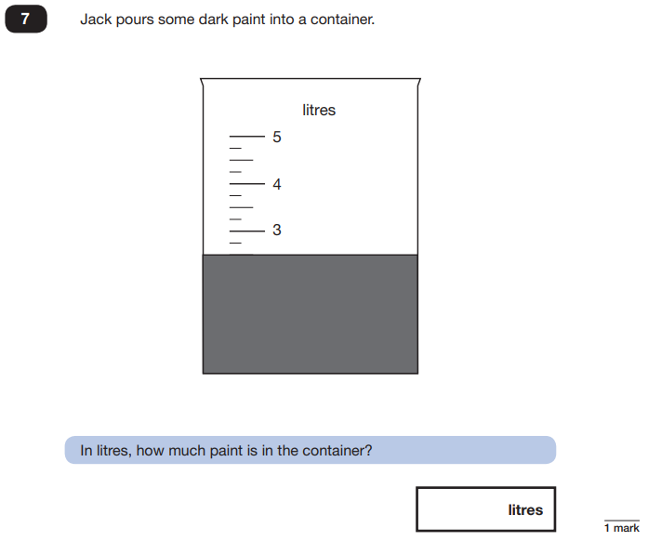
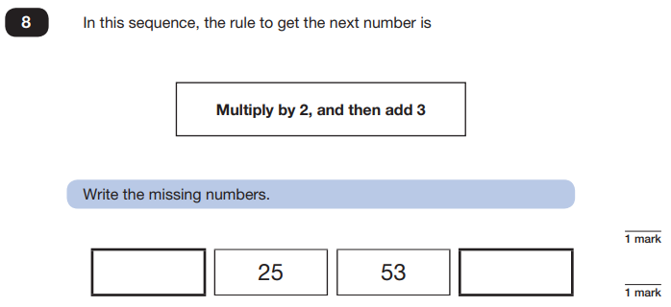
Maths Papers 2 (Reasoning)
The types of questions your child will encounter:
Multiple choice
True or false
Constrained questions, e.g. giving the answer to a calculation, drawing a shape or completing a table or chart
Less constrained questions, where children will have to explain their approach for solving a problem
Example questions:
11
109
2.5 or 2 ½

Slide 21
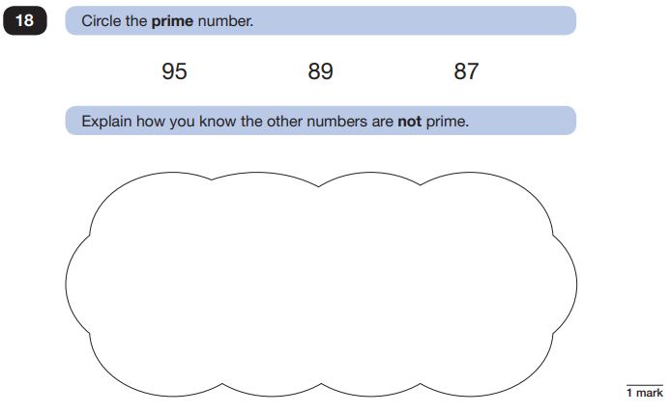
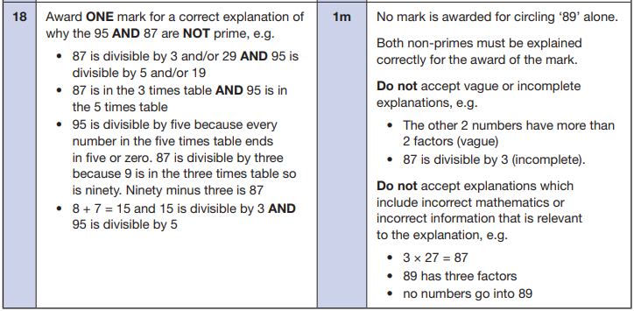
Maths Papers 2 (Reasoning)
Example question:

Slide 22
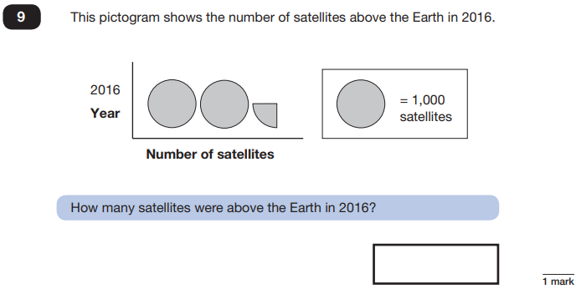
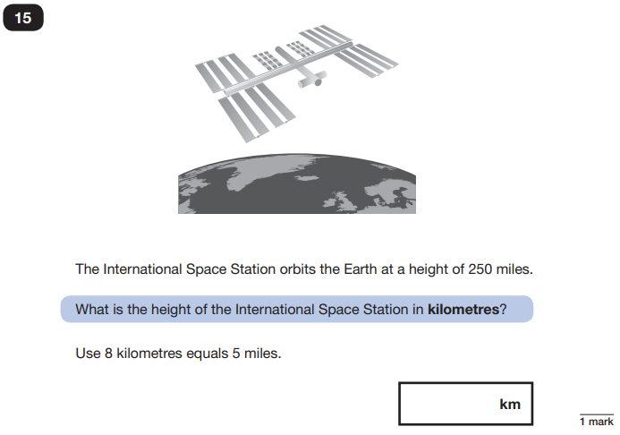
Maths Papers 3 (Reasoning)
Example questions:
2,250
400

Slide 23
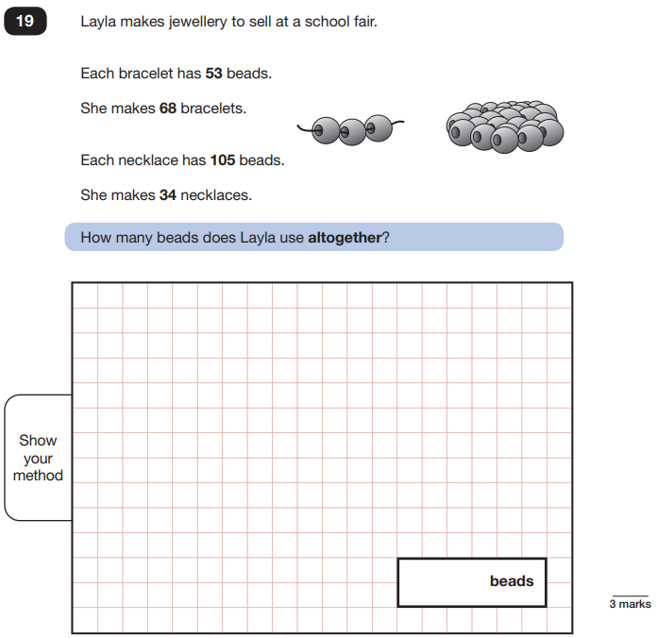
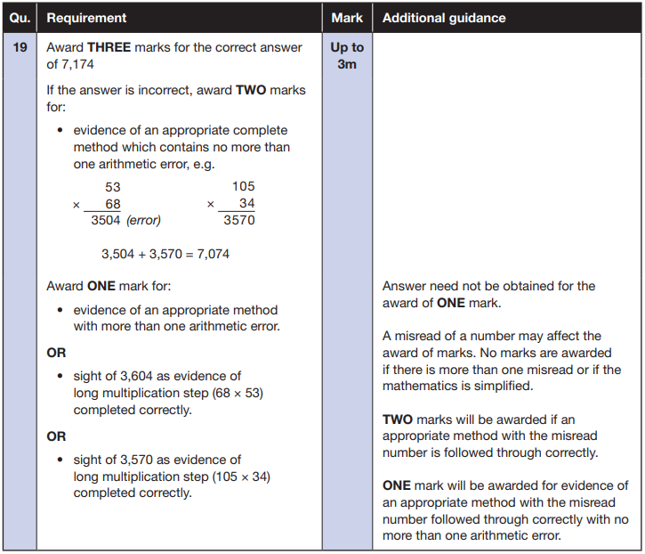
Maths Papers 3 (Reasoning)
Example question:

Slide 24
How we are preparing and supporting the children in the lead up to their SATs:
Firstly, we want to ensure that children feel prepared but not overwhelmed by these tests.
The year 6 team are planning the children’s lessons so that all content is covered by the time of the test, but these should feel like normal lessons to the children, rather than continued revision for a test.
Children are being taught in small groups so that the teaching can support children at their specific level of need, so that they can progress in their learning.

