Slide 1
Key Stage 1 SATs workshop
17th January 2023

Slide 2
Aims
• To know what the SATs are
• To find out what we mean by teacher assessment
• Know which subjects children will be tested in
• Share expectations for the end of Year 2
• Understand how to support your child

Slide 3
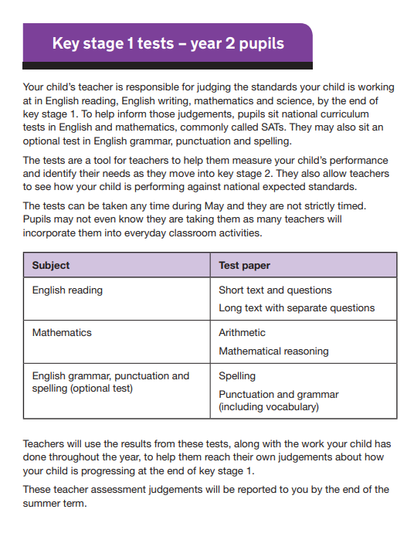
What are the SATs?
• The KS1 tests are designed to assess the children’s knowledge and understanding of the key stage one programmes of study in English and Maths.
• They provide evidence of children’s attainment.
• Teachers administer tests to help them arrive at a secure judgement for their final teacher assessment at the end of KS1.
We will confirm with you closer to the time the exact dates we plan to administer the tests in May. Sometimes we have done it over several weeks in small groups, other times we have done it in larger groups over a week. This depends on the needs of the cohort.

Slide 4
Teacher assessment
• Teachers make regular assessments to understand how children are progressing-these are called teacher assessments
• Final judgements are made towards the end of the Summer term
• Teacher assessments are collected from evidence in children's books, independent work samples and observations.
• The school will formally report the data to Tower Hamlets, some schools will be moderated
• The tests serve only as evidence on teacher's judgements, but it is the teacher assessment which is the most important of all

Slide 5
What do teachers assess?
• Reading
• Writing (no test)
• Mathematics
• Science (no test)

Slide 6
Assessment Levels
At the end of Key Stage 1, most children are expected to work at national expectations.
Levelled numbers are no longer given but broken down like this:
Working below national expectations
• Working towards the national expectations
• Working at the national expectations
• Working at greater depth

Slide 7
What do the SATs consist of?
• Mathematics-2 papers
Calculation-4 operations
Reasoning using the 4 operations including measures, shapes and data handling
Reading-2 papers
Basic comprehension and text
Complex reading strategies explored with more ambitious text Writing-Independent pieces of work across the year

Slide 8
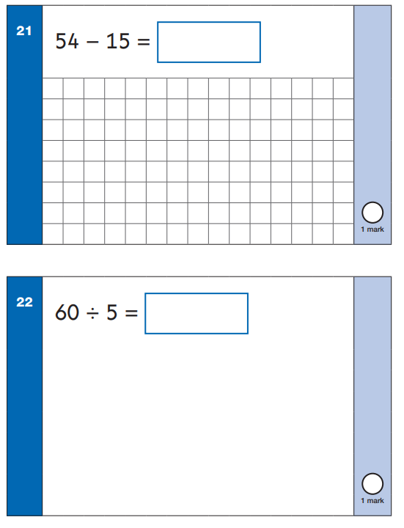
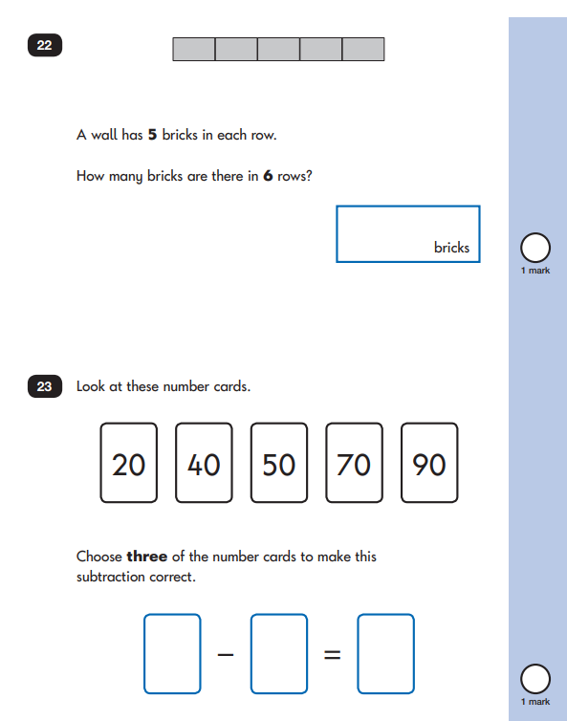
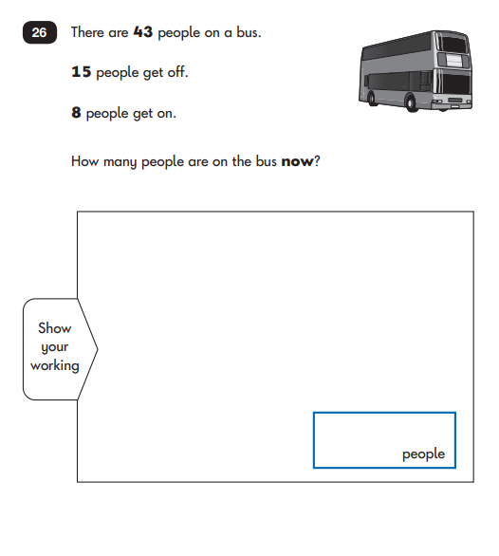
Key stage 1 tests: 2022 mathematics test materials - GOV.UK (www.gov.uk)

Slide 9
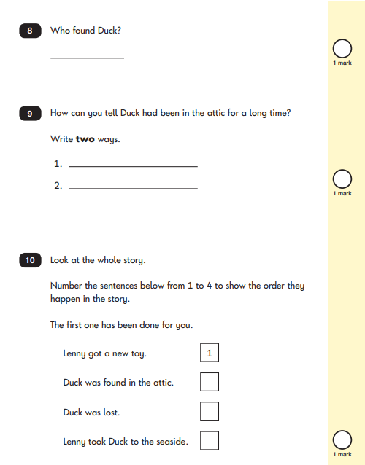
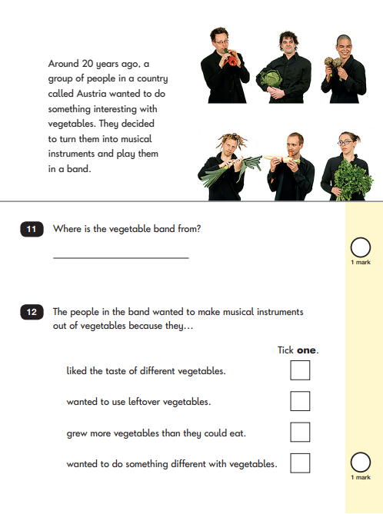
Key stage 1 tests: 2022 English reading test materials - GOV.UK (www.gov.uk)

Slide 10
Moderation
Some tests have timing guidelines but these are flexible
Maths-1 hour
Reading-Paper A, 30 minutes Paper B, 40 minutes
• Questions can be read to pupils in the maths papers but no support is given
• Children who are working significantly below the expected level do not have to sit the tests; teachers will discuss this with parents in the parent teacher meetings. A full teacher assessment will be made instead.

Slide 11
What happens if pupils perform differently during the test?
• If the test and teacher judgements differ from each other, then the teacher assessment will override the test results.

Slide 12
How to support your child
• Regular reading of different genres and developing good comprehension skills-Predict, evaluate, infer etc.
• Practise key mathematical concepts-all 4 operations and develop problem solving
• Practise neat handwriting at home and writing in a different style of genres. Encourage your child to ‘show off’ the different skills they have learnt, read their work when it is finished and improve it through editing.
All past papers are online.
You can buy resources from publishers such as CGP: https://www.cgpbooks.co.uk/primary-books/ks1/maths-english/em2b11-complete-ks1-maths-english-sat-buster
Twinkl has great resources too.

