Slide 1
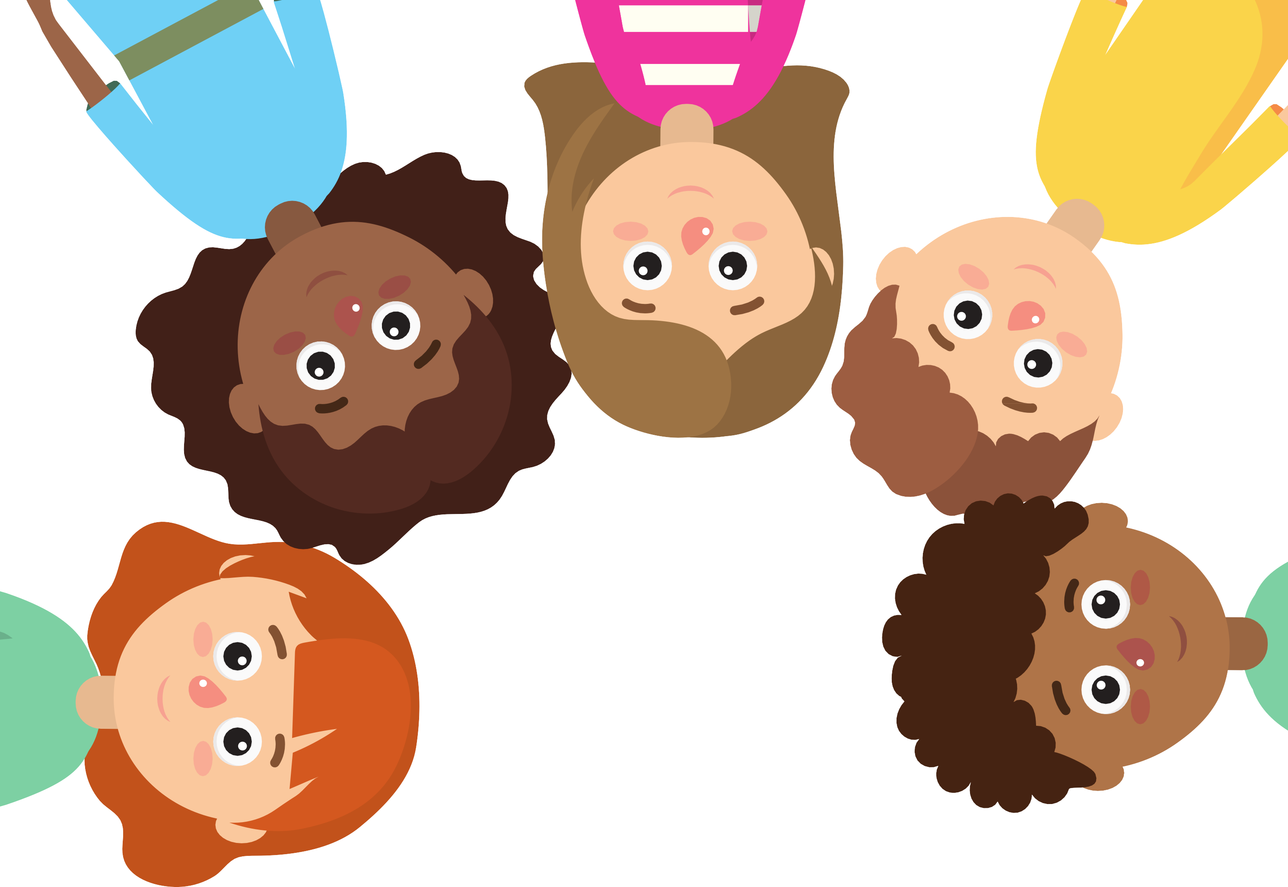
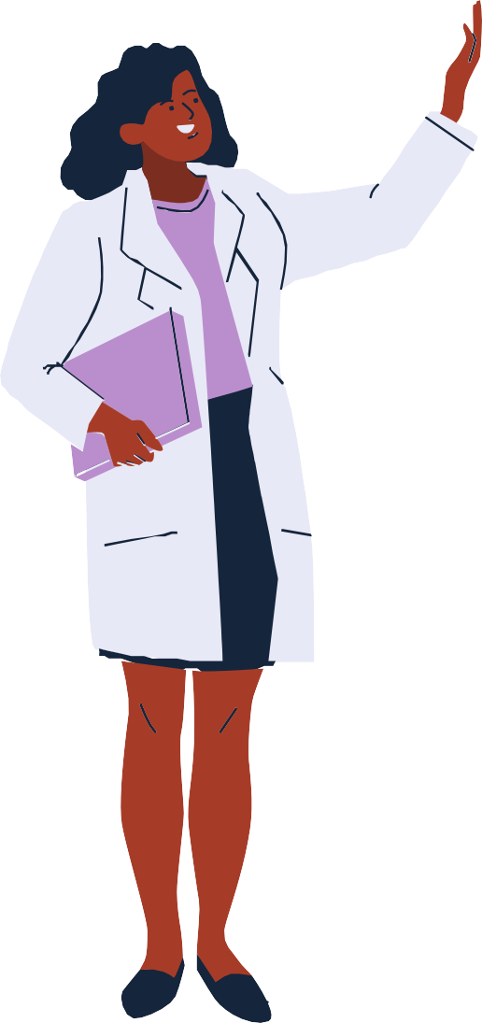
A story about returning to school

Slide 2
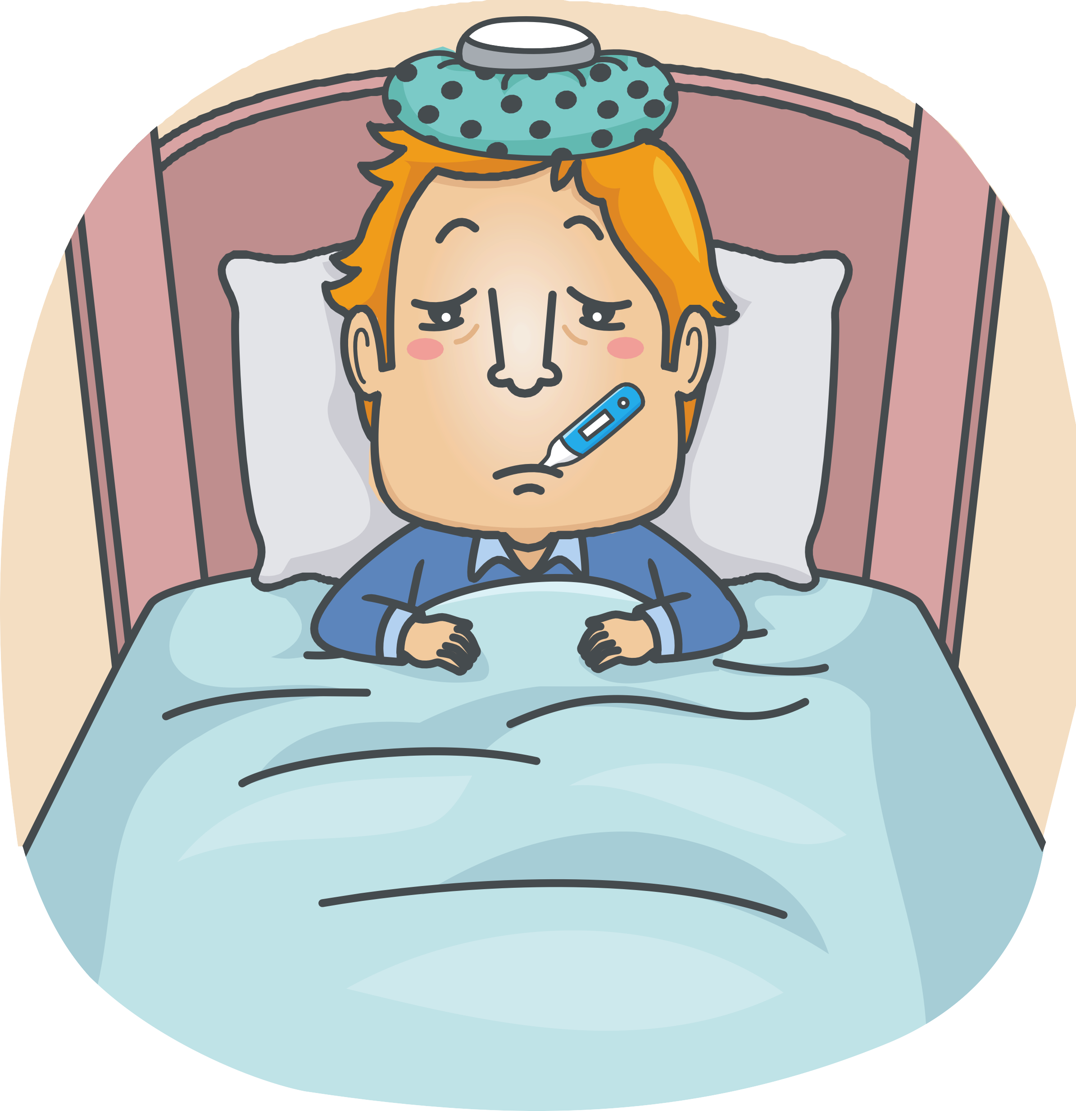
People can get sick.
Corona Virus is lots of little germs that make people
feel sick.

Slide 3
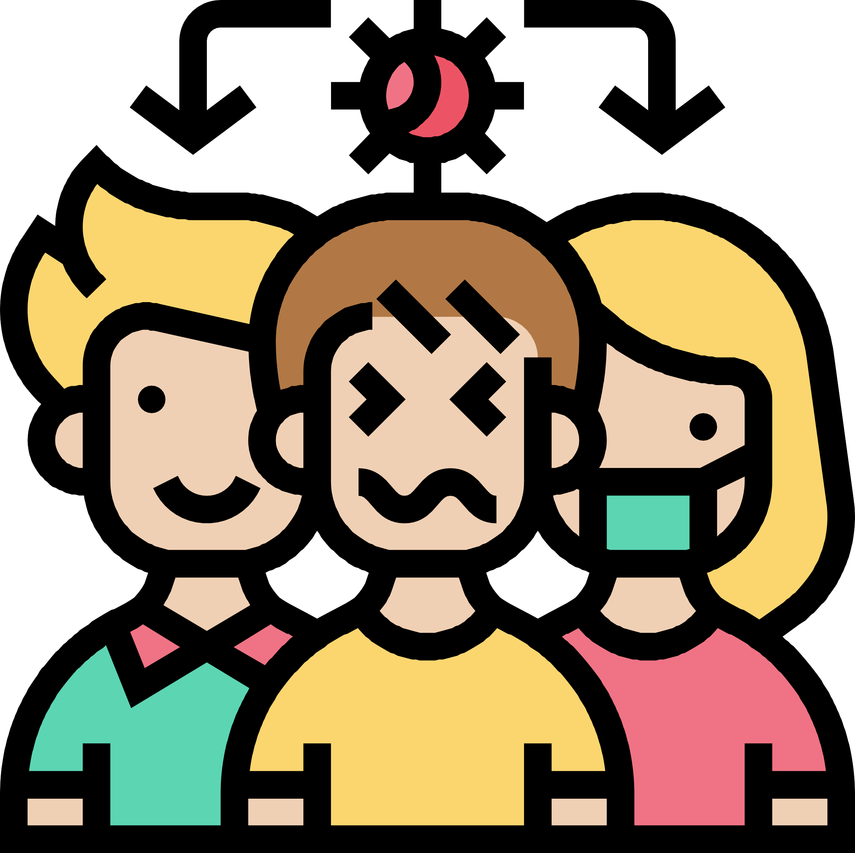
Corona Virus germs can be spread from one person to another and make them feel sick too.

Slide 4


It is mostly older people that need to take medicine, visit the doctor or go to the hospital if they get
Corona Virus.

Slide 5
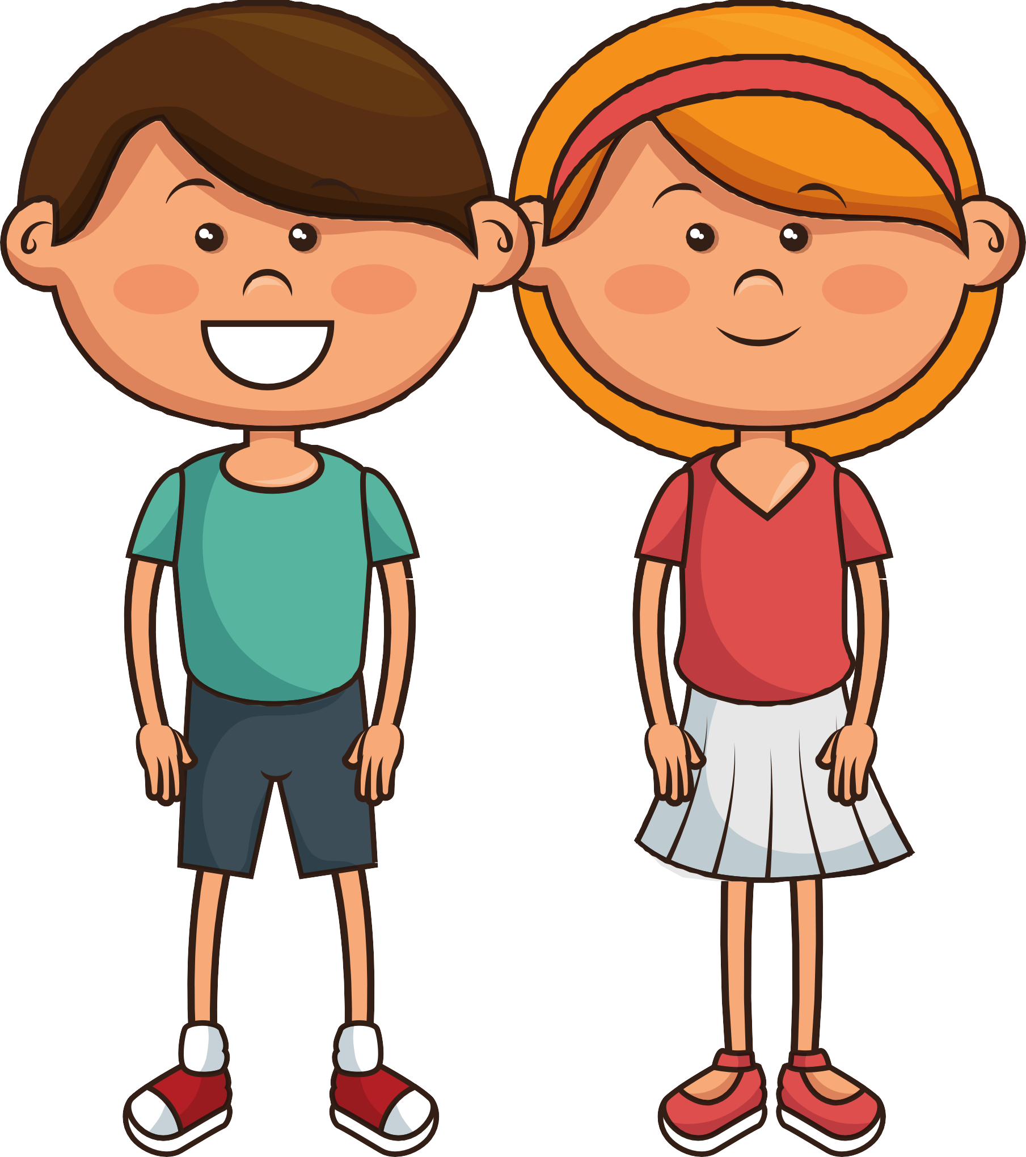
The doctors have told us that most children that get Corona Virus don't need to go to the doctor, take medicine or go to the hospital.

Slide 6
To keep everyone safe, we have been staying at home.

Slide 7

Staying at home to stop the spread of germs means we have been learning from home. Our grown-ups at home have been helping us.

Slide 8
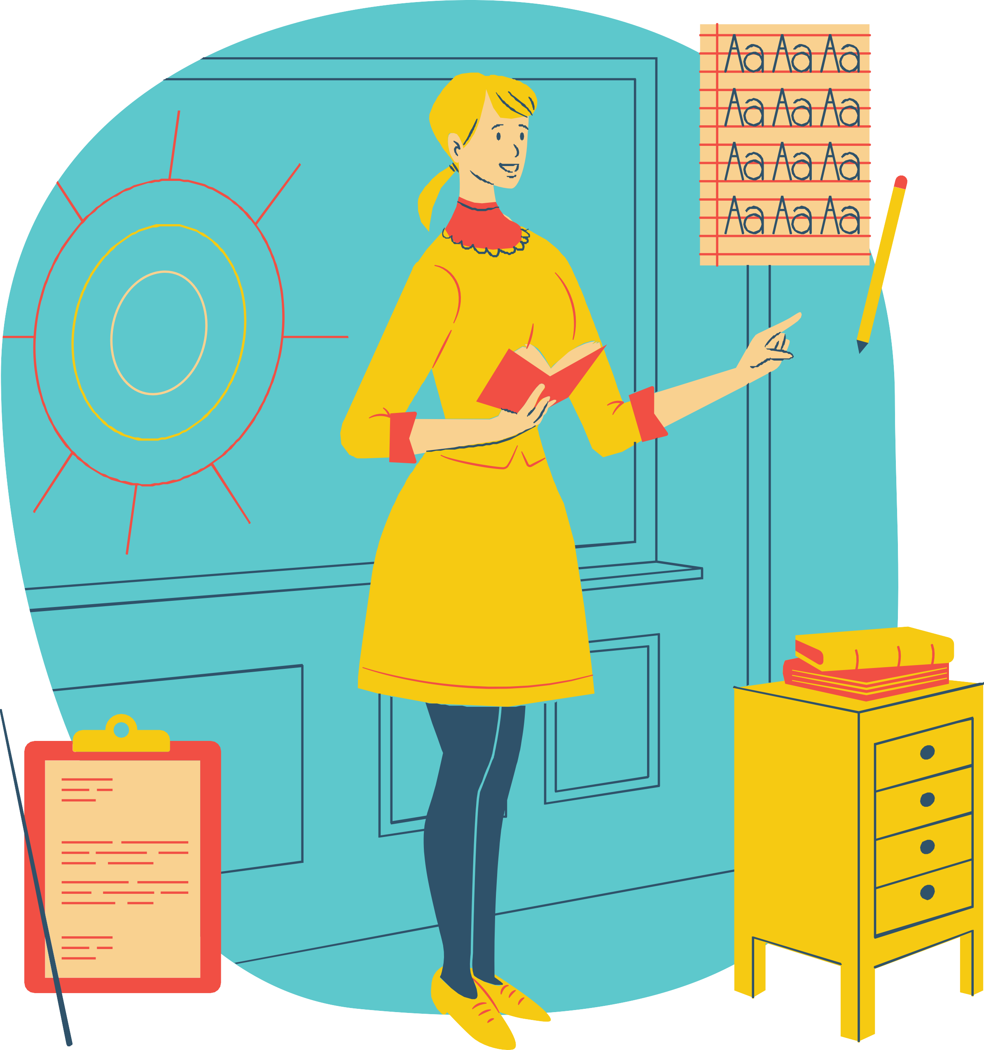
It is now time to go back to school.
To see your teachers, and your friends and to do your school work in the classroom instead of at home.

Slide 9


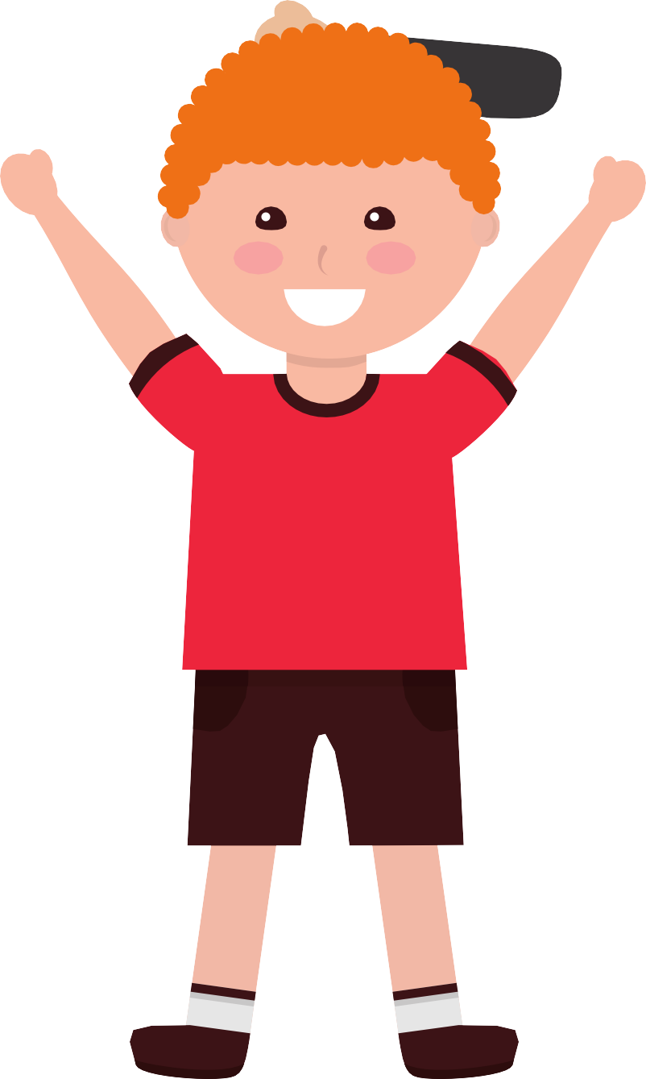
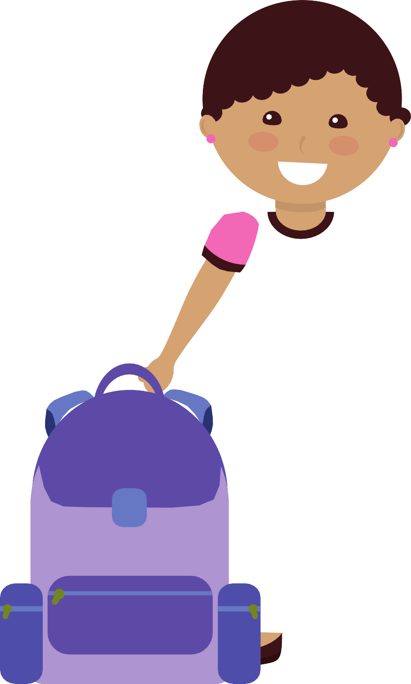
The adults in school are going to be so happy to see us come back. It is now safe to return to school. There are some things that are different, but this is to make sure we are kept safe.
Extra hand washing
Different lunch and break times

Slide 10
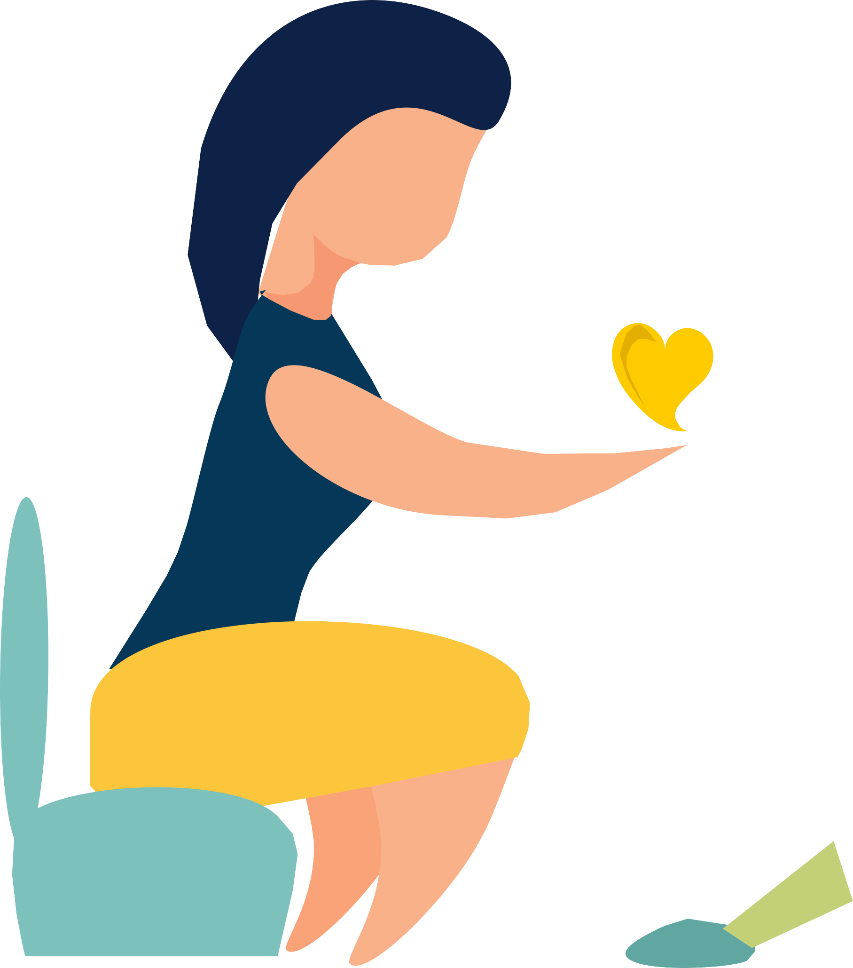
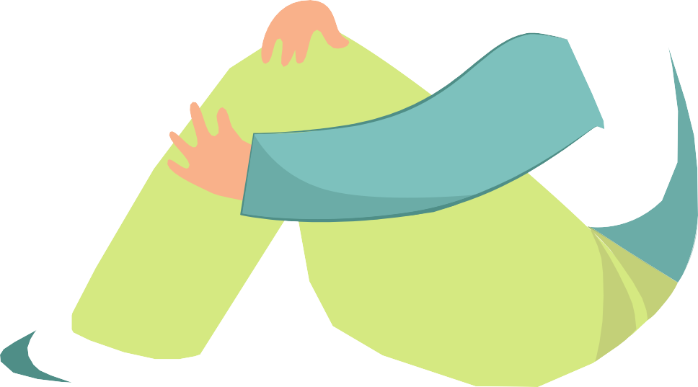
Even if I don't have my normal teacher, that's ok. I know all the teachers at school care about me and can help me.

Slide 11
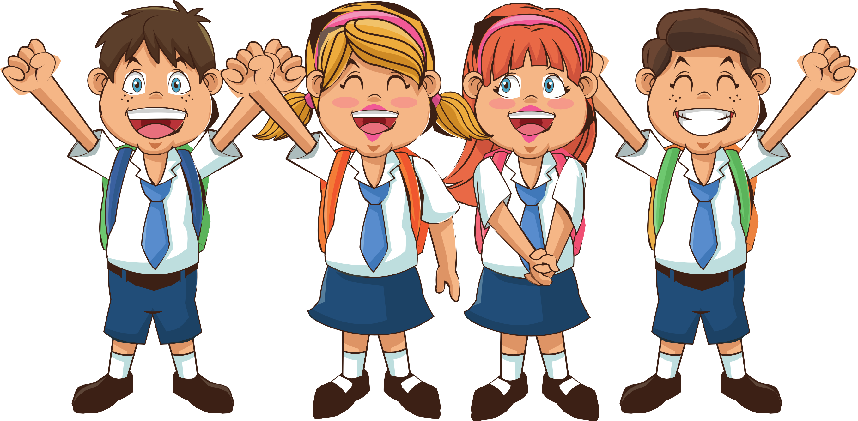
Some of my friends may be at school when I am at school.

Slide 12









Teachers will help me find a friend at break times.

Slide 13

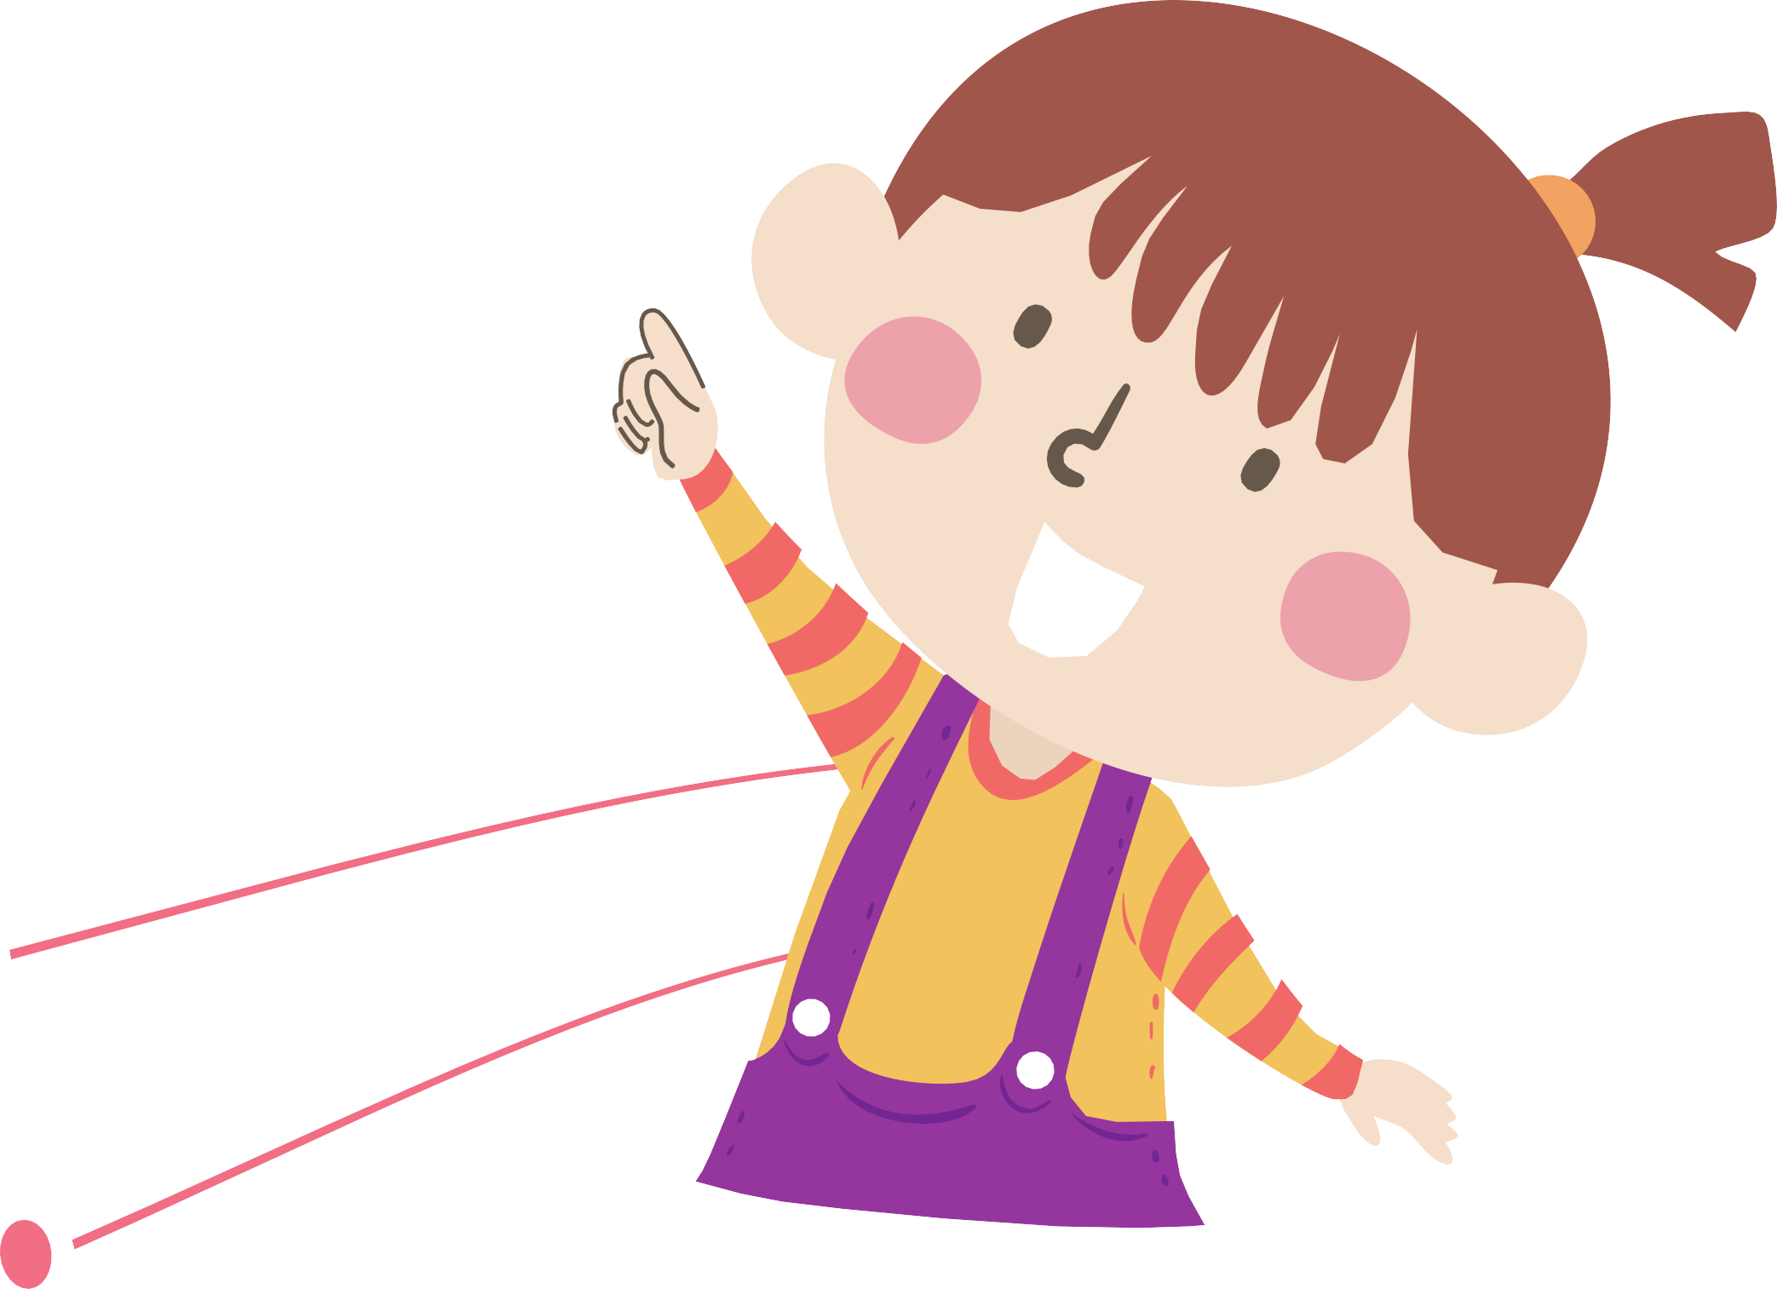
My teacher will tell me about some different rules to be safe and healthy at school.

Slide 14
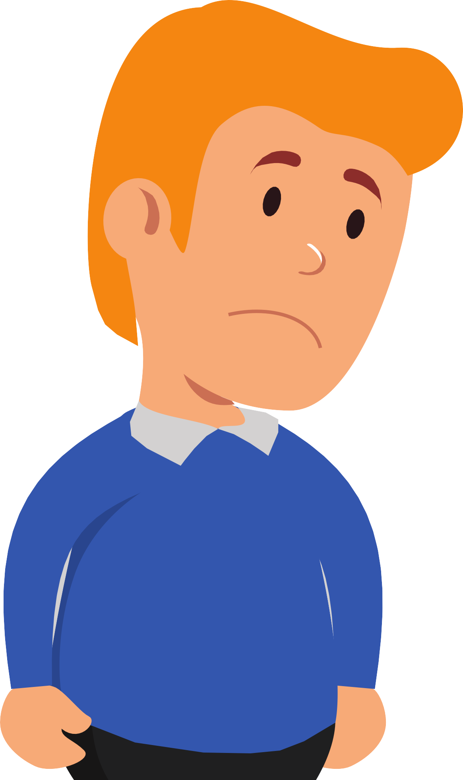
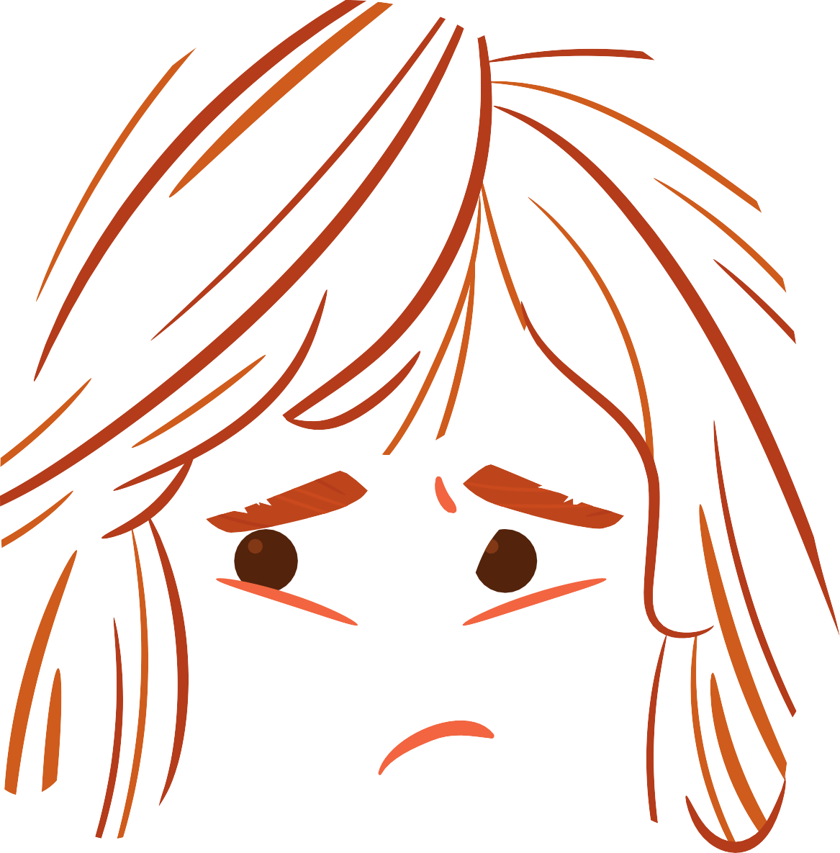
Sometimes these changes make me feel upset and
worried.

Slide 15
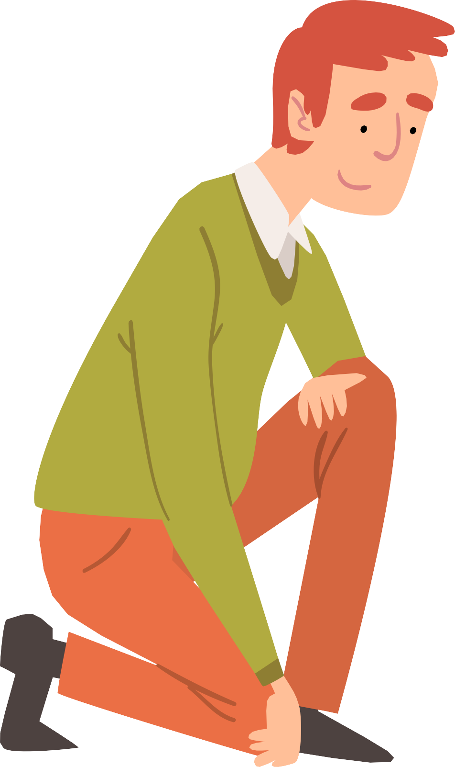
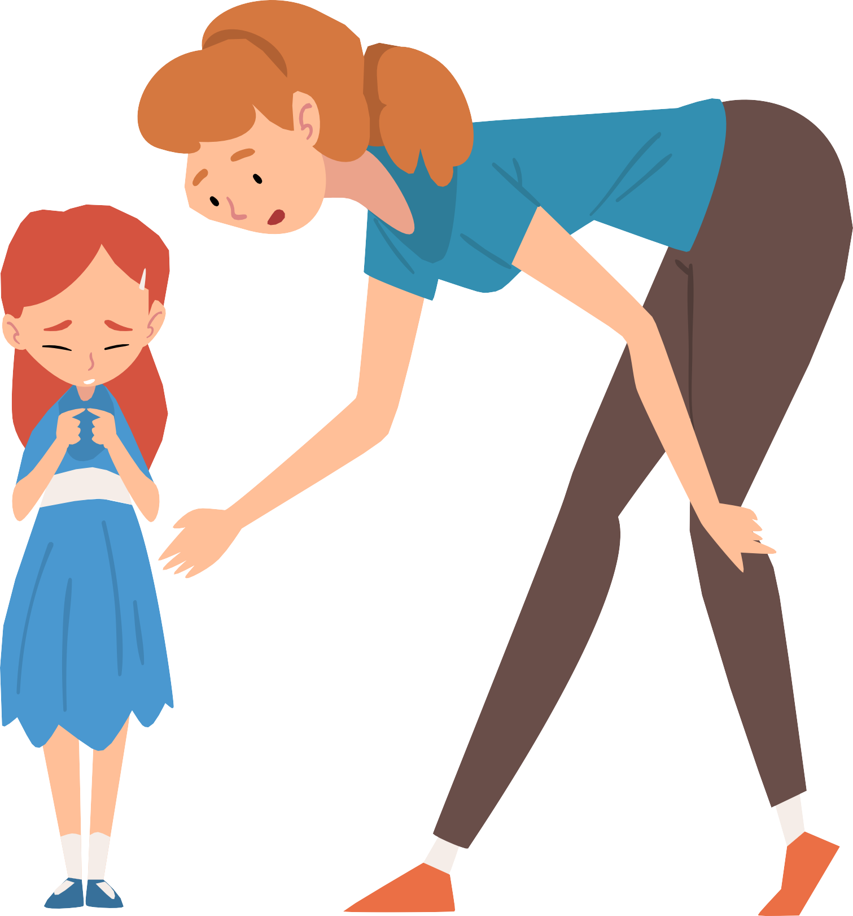
It is ok to feel worried and upset. My family and teachers can help me.

Slide 16

Soon we will be back at school everyday.

Slide 17
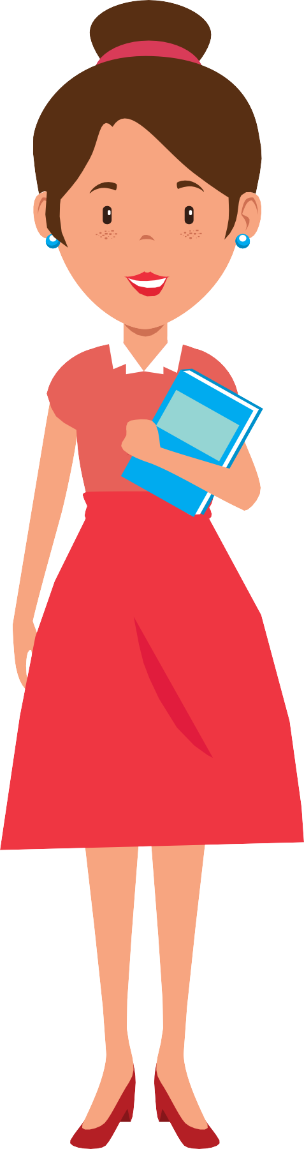

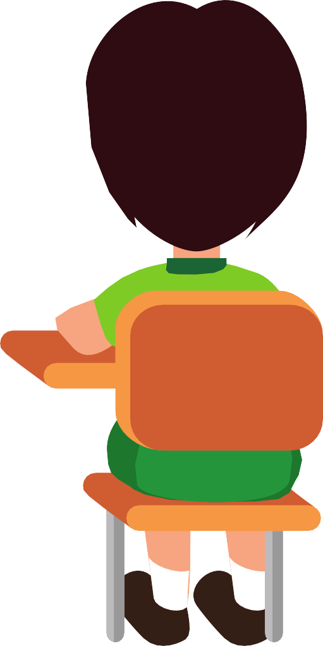
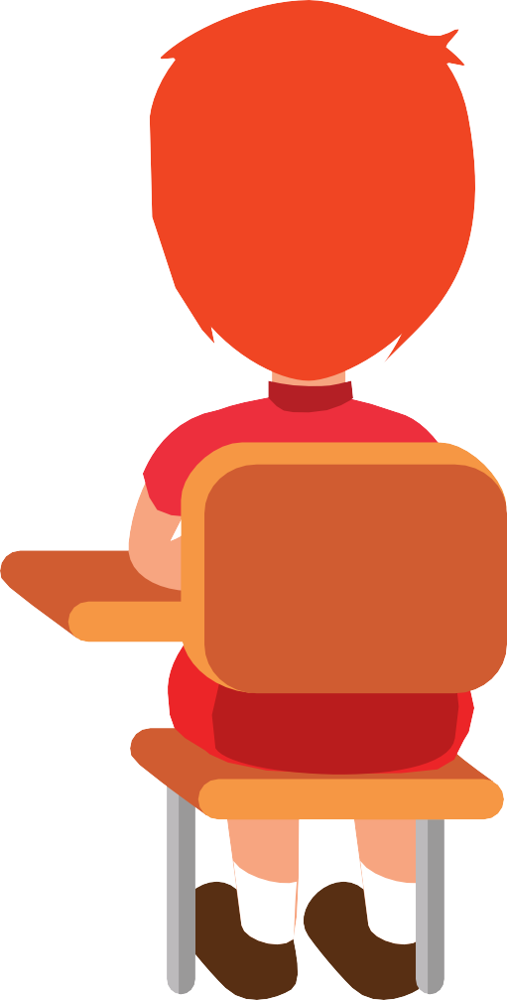

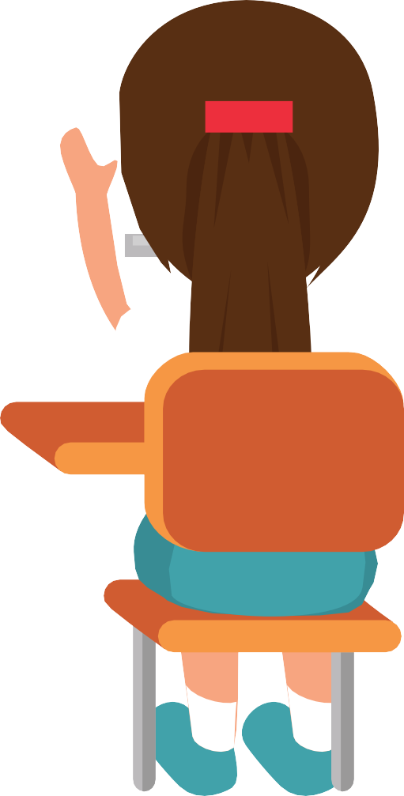


My teacher and friends will be so happy to see me.

Slide 18
The End

