Slide 1





Slide 2
What do we offer?
One-to-one interventions
Group interventions
Workshops

Slide 3
One-to-one interventions
Work with parents
Anxiety (aged 5 – 11)
  Nervous or shy
  Worries about family or friends
  Fears of animals or the dark
Behaviour (aged 4 – 8)
  Frequent tantrums
  Difficulty following rules
  Overly physical
8 – 10 weeks; 1 hour per session each week

Slide 4
Group interventions
Directly to whole classes or smaller groups of students
Delivered as a lesson
6 sessions, one a week
Emotion regulation to better understand and manage emotions

Slide 5
Workshops
Larger group sessions
Parents or staff
One-off, but sometimes as a short series
Mental health awareness, managing your child’s anxiety, transitions, identifying mental health needs, positive parenting and behaviour, and lots more.

Slide 6
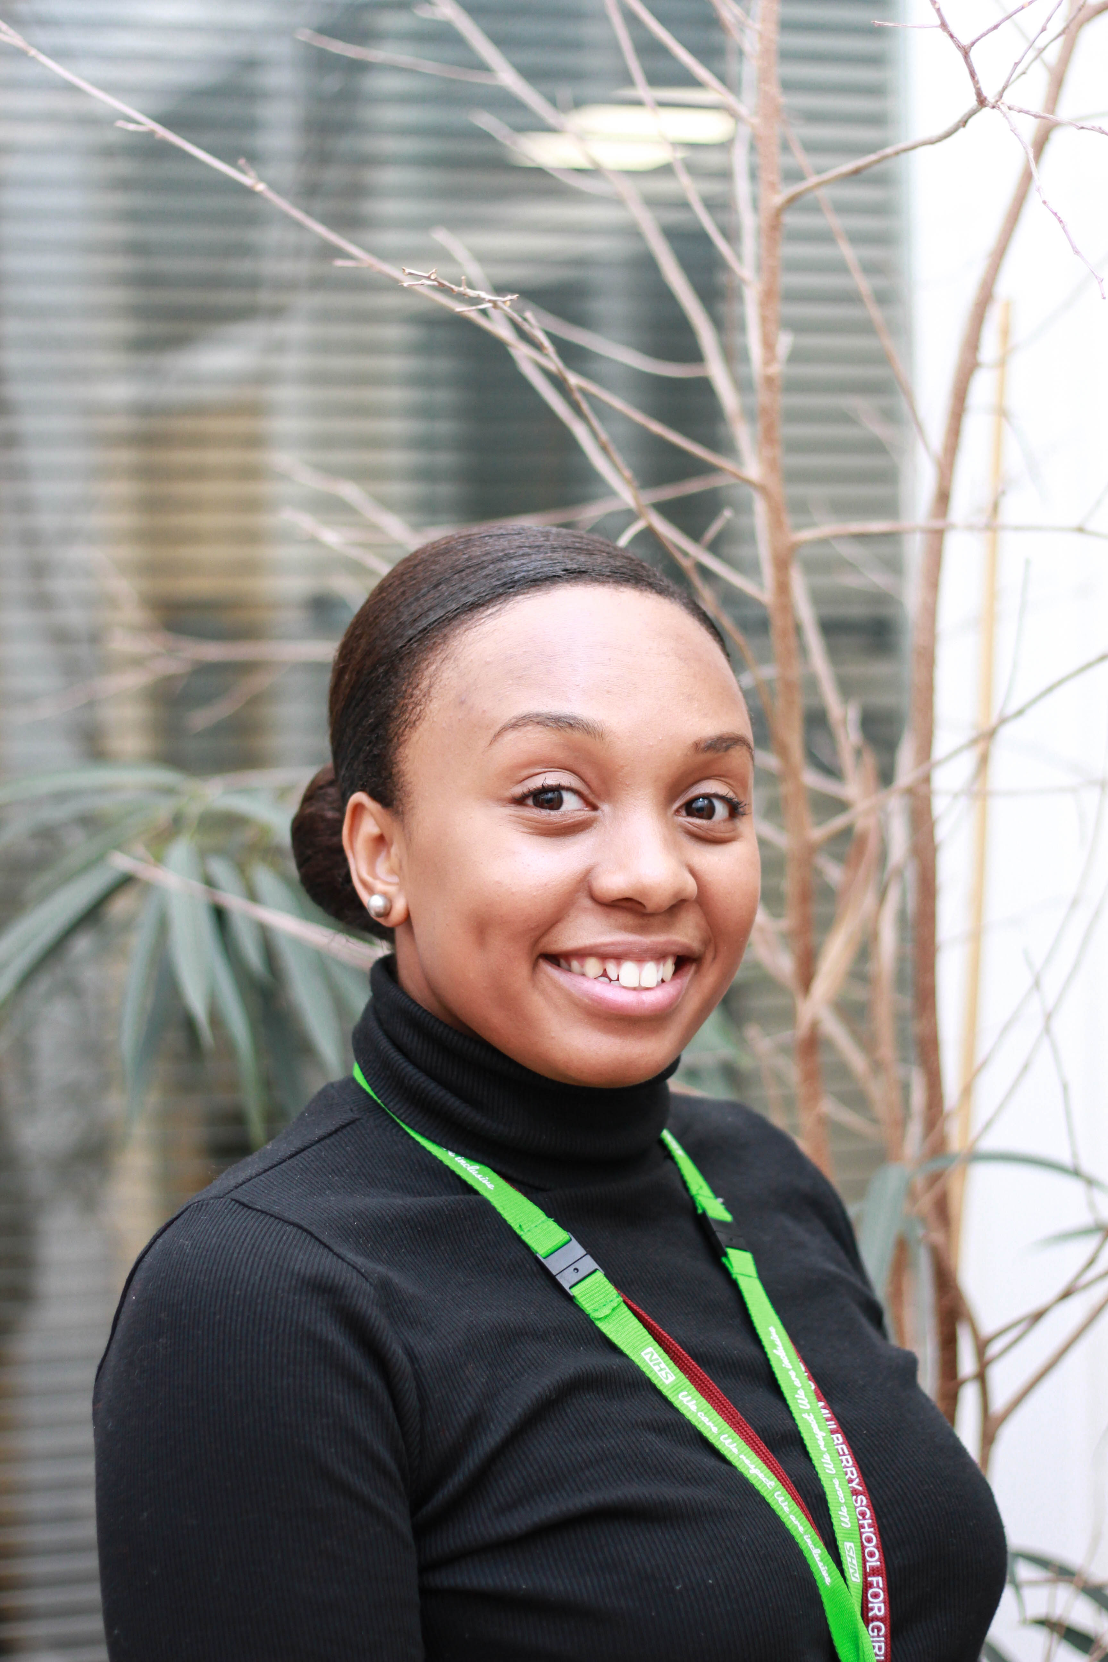
Who will I work with?
Education Wellbeing Practitioner (EWP)
Rachael

Slide 7
Know a student who needs support?
Please speak to the parent/carer about filling out an application form
Basic info (name, D.O.B etc.)
Brief description of what
student needs support with
Hand into SLT or
school link (if known)

Slide 8

Thank you for watching!

