Slide 1

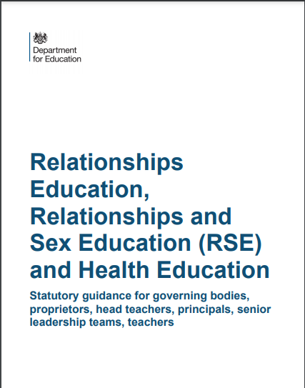
Relationships, Sex and Health Education
Parent information session
https://www.gov.uk/government/publications/relationships-education-relationships-and-sex-education-rse-and-health-education
St. Luke’s Church of England Primary School
v2018 short JF

Slide 2
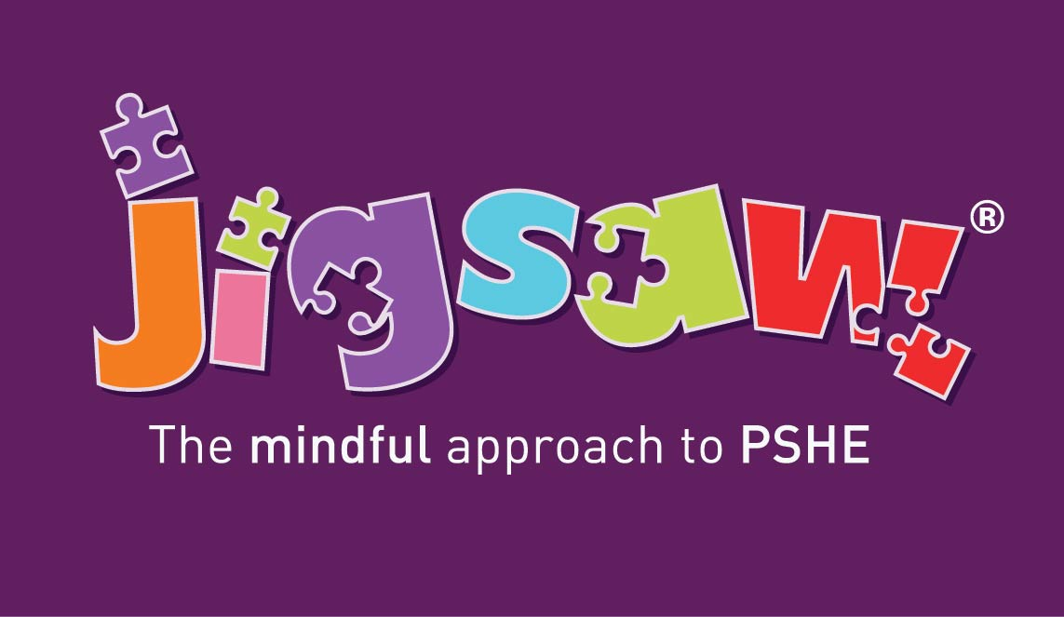
At St Luke’s we follow the Jigsaw PSHE (physical, social, health and economic education) scheme. This is the first recommended scheme by Tower Hamlets. Our RSE and H education is taught within our PSHE lessons.
Recap: Our PSHE journey
Relationships and sex education (RSE) and health education
‘The new curriculum will be compulsory from September 2020. Schools should start teaching from that date if they meet the statutory requirements. If they are not ready, or are unable to meet the requirements, they should begin teaching by at least the start of the summer term 2021.’
You may have heard some media coverage around the introduction of this new curriculum, particularly focussed on the sex education, which is in fact a small part of the curriculum.
It is a really exciting development, before this there had been no updates to the PSHE curriculum since the year 2000 – think how much society has changed in this time, and the different experiences and challenges pupils face today compared to the year 2000.
There is a lot of discussion around the importance of teaching children about mental health, positive body image etc.. All these topics are contained, age appropriately, within this curriculum.

Slide 3

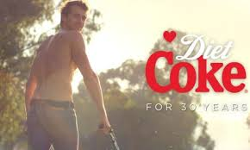
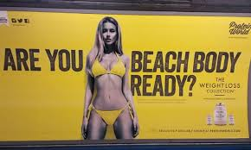
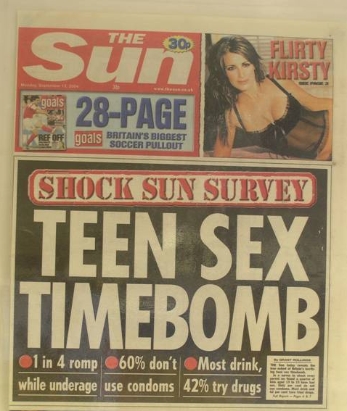


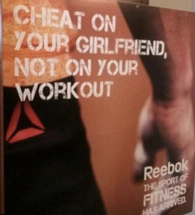



Today’s considerations
The internet
Television
Social media
Other media
Friends
Family
School
Notes:
Whole new world!
What do we have to consider when it comes to the needs and experiences of today’s children and young people? Is it very different from ‘in our day’?
NB: the logos are for Facebook, Twitter, Snapchat and Tinder.

Slide 4
Context
There have been many calls for statutory RSE and/or PSHE from leading parent representative bodies such as Mumsnet and PTA UK. A recent YouGov poll shows that 91% of parents believe all pupils should receive PSHE lessons to teach about the risks of sexting, as well as other issues such as contact from strangers online.
A recent Barnardo’s poll of 11-15 year olds also showed that 74% believed that children would be safer if they had age appropriate classes on RSE.

Slide 5
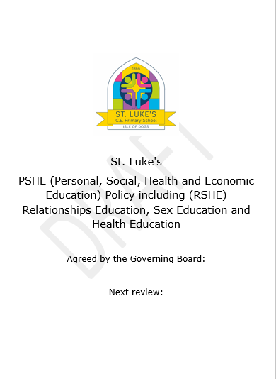
Our school policy
Introduction:
At St Luke’s we believe that PSHE is a vital part of children’s education if the children are to grow up confident, happy and safe. We have carefully considered the scheme of work chosen to ensure that it links with and supports our ethos and vision at St. Luke’s. The Jigsaw PSHE programme celebrates differences, raises aspirations and develops our pupils’ resilience to change. PSHE explicitly teaches this content, as well as threading this intent throughout all PSHE lessons. Our PSHE curriculum ensures we:
‘foster pupil wellbeing and develop resilience and character that we know are fundamental to pupils being happy, successful and productive members of society… [as well as developing] personal attributes including kindness, integrity, generosity and honesty.’
(RSHE Statutory Guidance, DFE, 2019)
This complements our school’s Christian values of safety, responsibility, kindness, respect, enthusiasm, partnership, fairness, honesty, excellence and courage which permeate the life of the school. By delivering the Jigsaw scheme of work we know that our pupils are equipped with the skills needed to not only navigate but flourish in our modern world, so they are able to live and work by our school’s Christian vision, ‘Hearts overflowing with truth and love’.
An amendment to the Children and Social Work Act 2017 made Relationships and Health Education statutory subjects from September 2020. Our scheme of work ensures all statutory duties are fulfilled, (see RSE mapping document for further information) and we are delivering this new statutory content through our established PSHE curriculum.

Slide 6
What is RSHE?
RSHE is part of the personal, social and health education (PSHE) curriculum in our school. Relationships Education and Health Education is statutory in all primary schools from September 2020.
The DFE recommend ‘…that all primary schools should have a sex education programme tailored to the age and the physical and emotional maturity of the pupils. It should ensure that both boys and girls are prepared for the changes that adolescence brings and – drawing on knowledge of the human lifecycle set out in the national curriculum for science – how a baby is conceived and born.’ (DFE guidance).
Principles and Values
St. Luke’s believes that RSHE should:
Recognise that the wider community has much to offer and we aim to work in partnership.
Be an integral part of the lifelong learning process, beginning in early childhood and continuing into adult life.
Be an entitlement for all young people.
Be set within the wider school context and support family commitment and love, respect and affection, knowledge and openness. Family is a broad concept; not just one model, e.g. nuclear family. It includes a variety of types of family structure, and acceptance of different approaches.
Equip children to have respect for themselves, both in the real world and online, enabling them to make appropriate choices.
Encourage students and teachers to share and respect each other’s views. We are aware of different approaches to sexual orientation, without promotion of any particular family structure. The important values are love, respect and care for each other.
Generate an atmosphere where questions and discussion on sexual matters can take place without any stigma or embarrassment.

Slide 7
Aims
Aims
We aim to deliver RSHE in a way that provides balanced factual information, and is sensitive to the broader backgrounds, beliefs and experiences of our community. Our RSHE programme aims to prepare children for an adult life in which they can:
Develop positive values and a moral framework that will guide their decisions, judgements and behaviour.
Have the confidence and self-esteem to value themselves and others.
Acquire the skills to judge what kind of relationship they want.
Understand the consequences of their actions, both in the real world and online, so they know how to behave responsibly within relationships.
Communicate effectively by developing appropriate terminology for sex and relationship issues.
Secure an understanding of how to look after their own emotional wellbeing and the links between respecting your body and your mind.

Slide 8
Science and PSHE – what’s the difference?
Science Key Stage 1
PSHE Key Stage 1
identify, name, draw and label the basic parts of the human body and say which part of the body is associated with each sense
notice that animals, including humans, have offspring which grow into adults
The names for the main parts of the body (including external genitalia) the similarities and difference between boys and girls
how to maintain physical, mental and emotional health and well-being
how to manage risks to physical and emotional health and well-being
ways of keeping physically and emotionally safe
about managing change, such as puberty, transition and loss
how to make informed choices about health and well-being and to recognise sources of help with this
Notes:
Relationships and Sex Education at St Luke’s takes place within Science and PSHE lessons (for Statutory and non-statutory guidance see appendix 1.)
Show the difference between Science and PSHE – and that there are some overlaps.
The wording in bold shows this is also taught in KS2.

Slide 9
Science and PSHE – what’s the difference?
Science Key Stage 2
PSHE Key Stage 2
describe the differences in the life cycles of a mammal, an amphibian, an insect and a bird
describe the life process of reproduction in some plants and animals
describe the changes as humans develop to old age
learn about the changes experienced in puberty
how their body will change as they approach and move through puberty
about human reproduction
how to develop and maintain a variety of healthy relationships, within a range of social/cultural contexts
how to recognise and manage emotions within a range of relationships
how to recognise risky or negative relationships including all forms of bullying and abuse
how to respond to risky or negative relationships and ask for help
how to respect equality and diversity in relationships
Notes:
Show the difference between Science and PSHE – and that there are some overlaps.
The wording in bold shows this is also taught in KS2.

Slide 10
What is Jigsaw?
A whole school programme, which comprises
A comprehensive and completely original scheme of work for Nursery and Reception to Year 6
PSHE (Personal, Social, and Health Education), emotional literacy, social skills, and spiritual development (SMSC)
A detailed weekly lesson plan for all year groups, including all teaching resources
Notes:
We choose to teach this with the Jigsaw scheme.
Plenty of research done – other schools, advice from the LA and other schemes and this was the one that we felt was the best.

Slide 11
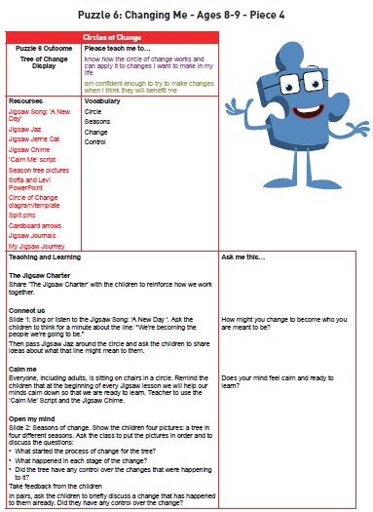
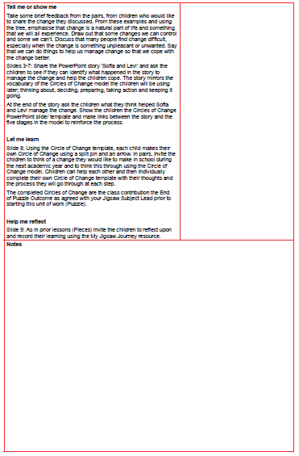
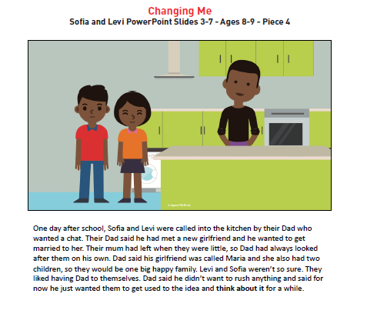

Slide 12
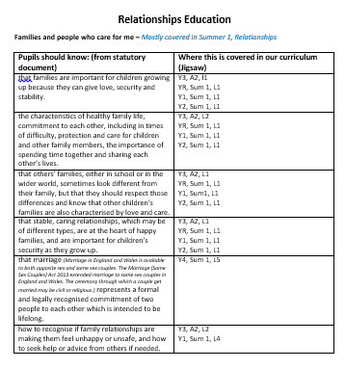
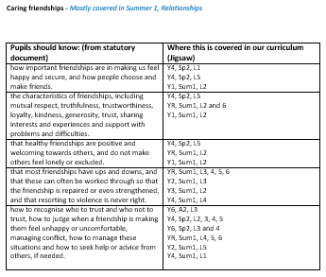
We have mapped each statement from the statutory RSHE curriculum onto Jigsaw so we know where it is being taught.

Slide 13
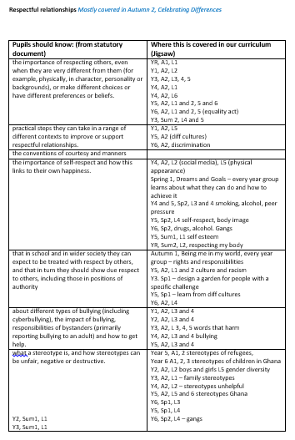
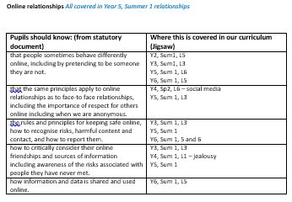
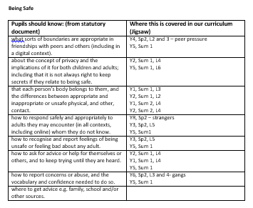

Slide 14
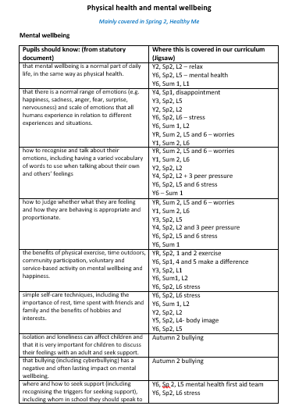
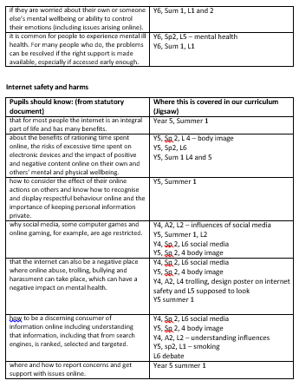

Slide 15
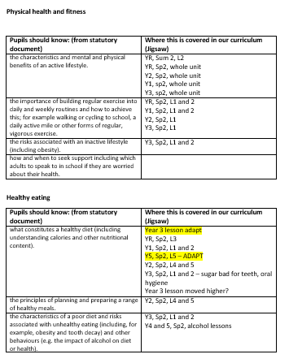

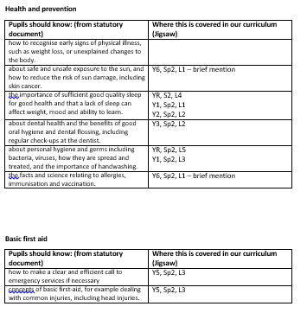

Slide 16
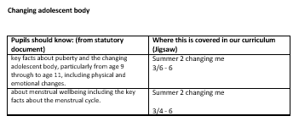
All of this content is statutory.
Body parts are taught in KS1 for safeguarding reasons.
​Puberty is introduced in Y3 then taught with more detail and space for pupils to ask questions from Y4-Y6. This is because girls can start their periods when they are 8.

Slide 17
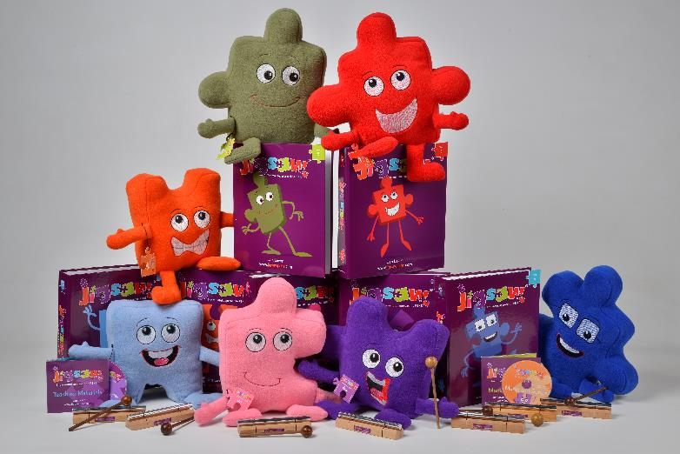
Jigsaw PSHE
Being Me in My World
Celebrating Difference
Dreams and Goals
Healthy Me
Relationships
Changing Me
Notes:
These are the units of study in Jigsaw PSHE. Briefly explain what is in each unit/Puzzle:
Being Me In My World: A sense of belonging; Welcoming others; Building the positive and nurturing ethos of the class/school; Being part of a school community, a wider community, a global community; Rights (UNCRC) and responsibilities; Working and socialising with others; School Council and pupil voice; The Learning Charter: rights, responsibilities, rewards and consequences.
Celebrating Difference: Similarities and differences – diversity; Appearance, disability, racism, power, friendships, conflict; Accepting everyone’s right to ‘difference’, regardless of their circumstances or choices; What is ‘normal’?; Bullying – what it is and what it isn’t, including cyber and homophobic bullying.
Dreams and Goals: Hopes and dreams; Goals to success; Learning and personal strengths; Challenges – team work skills and tasks; Overcoming obstacles; Enterprise and fundraising; Experiencing and managing feelings of pride, ambition, disappointment, success; Aspirations – jobs and careers; Dreams and goals of others in different cultures/countries; Dreams for the world .
Healthy Me: Emotional health (Relaxation, being safe, friendships, mental health skills, body image, relationships with food, managing stress) and Physical health (Eating a balanced diet, physical activity, rest and relaxation, keeping clean, drugs and alcohol, being safe, first aid).
Relationships: Families; Friendships; Love and Loss; Memories; Grief cycle; Pets and animals; Safeguarding and keeping safe; Attraction; Assertiveness; Conflict; Own strengths and self-esteem; Cyber safety and social networking; Roles and responsibilities in families; Stereotypes; Communities; Wider communities
Changing Me: Life cycles; How babies are made; My changing body; Puberty; How babies grow; Growing from young to old; Becoming a teenager; Assertiveness; Self-respect; Safeguarding; Family stereotypes; Self and body image; Attraction; Change; Accepting change; Looking ahead; Moving/transition to secondary.

Slide 18
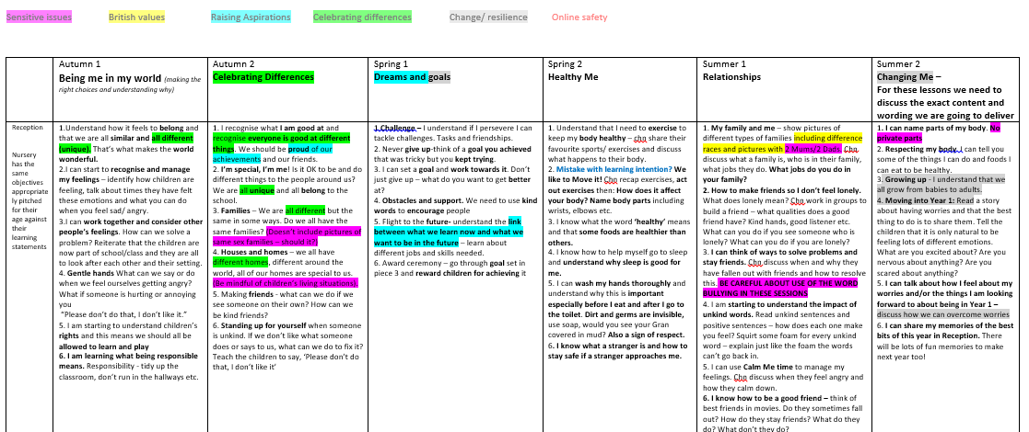
We have mapped the full content of the Jigsaw scheme into our own format. This means the subject leader knows exactly what is coming up each half term, and adjustments have been made in discussion with staff to adapt the curriculum to suit our pupils and community. The subject leader then discusses with teachers each half term what will be covered, to ensure we are covering the agreed content.
Jigsaw mapping document
We have made some changes to the Jigsaw content, particularly around the ‘Changing Me’ unit. This is all recorded here in detail, as well as in the policy.

Slide 19
LGBTQ issues
All of our teaching is sensitive and age appropriate in content. The DFE states in the introduction of their statutory guidance, ‘we expect all pupils to have been taught LGBT content at a timely point as part of this area of the curriculum.’ As an inclusive school we value all of our pupils and families in our community and comply with the Equality Act 2010 under which sexual orientation and gender reassignment are amongst the protected characteristics. We do not teach children about LGBTQ or heterosexual adult relationships as this would be inappropriate. Instead we focus on respect and regard between people e.g. friendships and families. Justin Welby, Archbishop of Canterbury states in ‘Valuing All God’s Children’:
‘Central to Christian theology is the truth that every single one of us is made in the image of God. Every one of us is loved unconditionally by God. We must avoid, at all costs, diminishing the dignity of any individual to a stereotype or a problem. Church of England schools offer a community where everyone is a person known and loved by God, supported to know their intrinsic value. This guidance helps schools to offer the Christian message of love, joy and the celebration of our humanity without exception or exclusion.’
In Early Years and KS1 children will be taught that there are lots of different types of families and shown images of different types of families.
In Year 3 lessons about bullying will give teachers the opportunity to correct homophobic language, just as they would any language associated with racism, sexism or any other type of discrimination. Following Tower Hamlets guidance children will be given a brief description of what a lesbian is, “a woman who loves another woman” and what a gay man is, “a man who loves another man.” In the Year 4 lesson ‘Girlfriends and boyfriends’ in the ‘Relationships’ unit children will be told that some people may be attracted to people of the same sex, and just like a heterosexual relationship this is for when you are much older. When marriage is taught we explain the law allows people in same sex or heterosexual partnerships to get married. In Year 6 children will learn about the Equality Act and be introduced to the word ‘transgender’ as part of lesson on celebrating and understanding differences. This lesson has a focus on prejudice and discrimination.
Any questions posed by children which go beyond the agreed content for that year group will be responded to age-appropriately.

Slide 20
Sex education
Statutory content of the science curriculum related to Sex Education includes:
Naming the main external body parts (KS1)
The human body as it grows from birth to old age (including puberty)
Reproduction in some plants and animals
The DFE states in their guidance on Relationships Education, Relationships and Sex Education (RSE) and Health Education Statutory Guidance:
‘It is important that the transition phase before moving to secondary school supports pupils’ ongoing emotional and physical development effectively. The Department continues to recommend therefore that all primary schools should have a sex education programme tailored to the age and the physical and emotional maturity of the pupils. It should ensure that both boys and girls are prepared for the changes that adolescence brings and – drawing on knowledge of the human life cycle set out in the national curriculum for science - how a baby is conceived and born... Meeting these objectives will require a graduated, age-appropriate programme of sex education.’
Following this advice we have adapted the Jigsaw unit ‘Changing Me’ to suit the needs of our pupils. More than ever, children are exposed to representations of sex and sexuality through the media/ social media and culture around them, and we wish to present a balanced and age appropriate view of this content for our pupils to help them be discerning and stay safe. We have chosen to deliver the non-statutory but DfE advised content about conception in Year 6. This decision will be reviewed depending on cohorts, and if it was changed parents would be consulted as necessary.
This non-statutory content will be taught after consulting with parents.
Parents have the right to withdraw from the non-statutory parts of this curriculum.

Slide 21
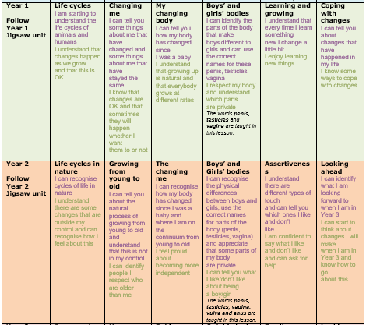
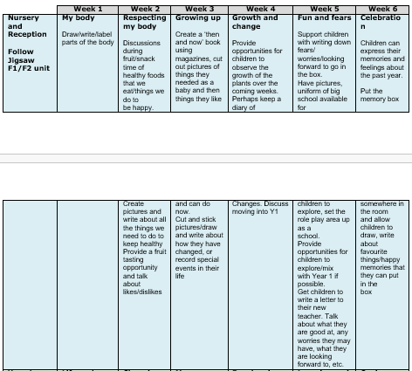

Slide 22
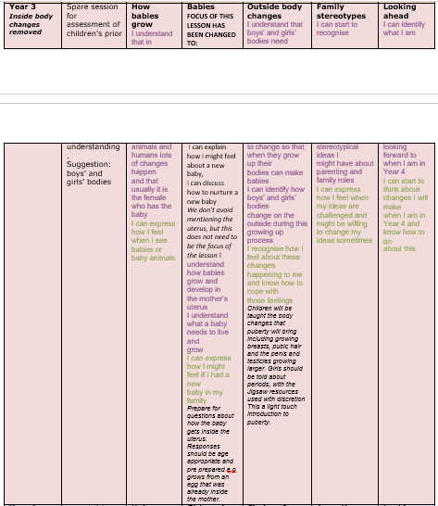
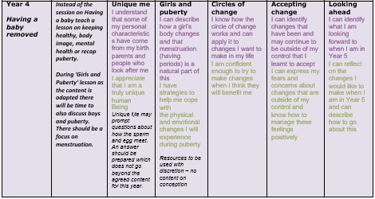

Slide 23
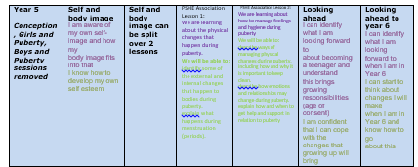
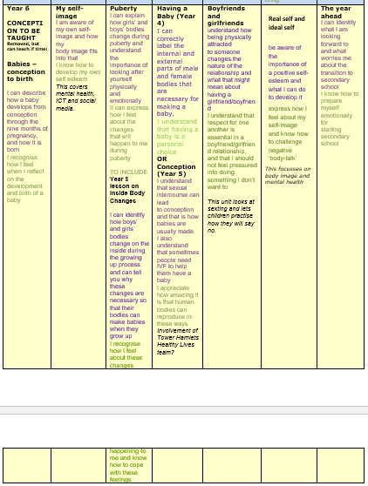

Slide 24
We teach about the act of conception, as advised by the DFE, in Y6. This part is non-statutory and parents have the right to withdraw.
All staff will have CPD annually to prepare them before teaching the content of the Changing Me lessons to ensure everyone is confident and secure with what they are teaching. Resources will be agreed on and the subject leader will be able to ensure there is a graduated, age appropriate approach.
Difficult questions
All staff will be prepared for questions and will not give information beyond the content agreed after parent consultation for that year group. For lessons where difficult questions are expected to arise teachers will have a question box. Pupils will post their questions and teachers will have time to prepare and consult over the answers they give.

Slide 25
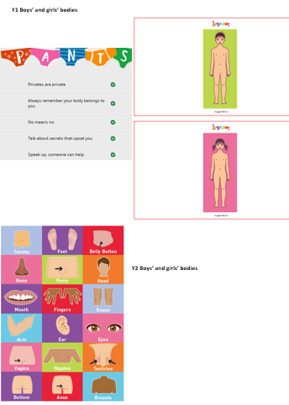
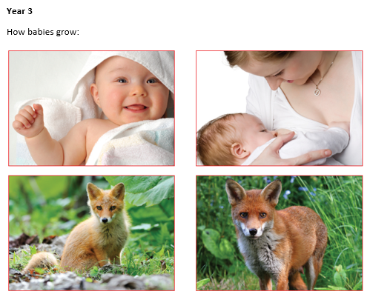

Slide 26
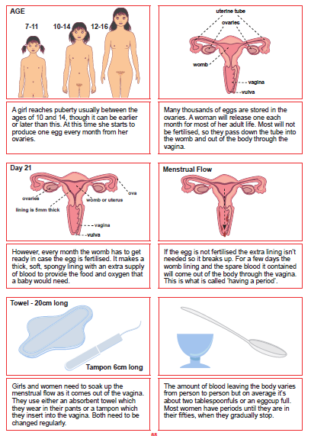
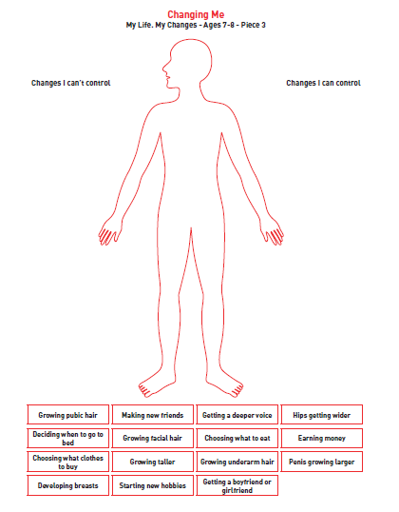
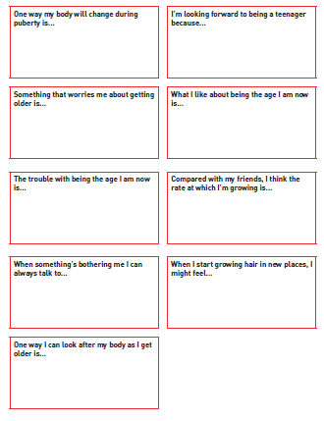

Slide 27
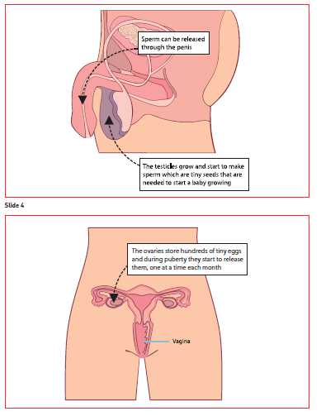
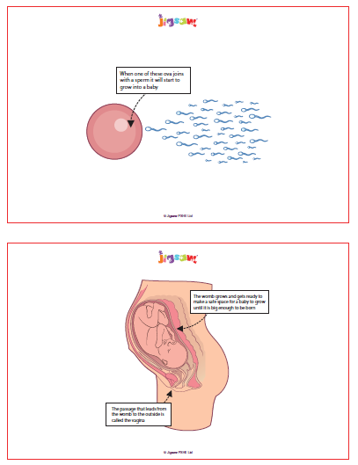
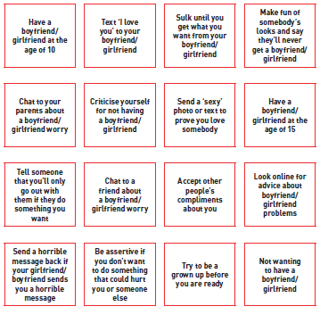

Slide 28
The Role of Parents and the Right of Withdrawal of Students from Relationships Education
The school is well aware that the primary role in children’s RSE lies with parents and carers. We therefore wish to build a positive and supporting relationship with the parents of children at St Luke’s, through mutual understanding, trust and cooperation. To promote this objective we:
• Inform parents about the school’s RSE policy and practice.
• Answer any questions that parents may have about the RSE of their child.
• Take seriously any issues that parents raise with teachers or governors about this policy, or about the arrangements for RSE in the school.
• Make the RSE resources used in our lessons available for viewing.
Any parent or carer with any concerns or worries about the RSE are asked to meet with the head teacher to discuss any issues they may have at the earliest opportunity, with a view to minimising any withdrawal from the non-statutory content of the lessons. We will always aim to resolve any concerns so that all children can participate in RSE in school.
Notes:
Partners in learning – we are seeking to help you by educating children on this topic, we need your help so that if there are any sensitivities we need to be aware of in advance – you let us know what they are,

Slide 29
Don’t forget…
We are educating children and young people to live in the real world, with all its contradictions
When it comes to sex, children’s heads are probably not empty – but they may be full of myths and half-truths
We mustn’t let our adult knowledge of relationships and sex prevent us seeing things from the child’s perspective
Our focus should be on building healthy attitudes and positive relationships, not just fighting off perceived threats
Notes:
It is really important to emphasise how we as adults can often put our own concerns/prejudices, etc. on to children and that this can distort the information we give.

